Slide 1
Whistleblowing
Kathleen, Kriss, Ryan & Sam

Slide 2
What is Whistleblowing?

Slide 3
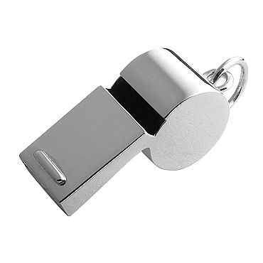
The Basics of Whistleblowing
Whistleblower- someone who brings issues in their organization to light, examples:
Misconduct
Alleged dishonesty
Illegal activity
Violation of a law, rule, regulation
Direct threat to public interest
Fraud, health/safety violations, corruption

Slide 4
The Basics (cont.)
Internal whistleblowing
To other people within the accused organization
Most common
External whistleblowing
To regulators, law enforcement agencies, the media or to groups concerned with the issues
Ends up involving lawyers, court cases and a lot more drama than internal (depending on the severity of the claims being made)

Slide 5
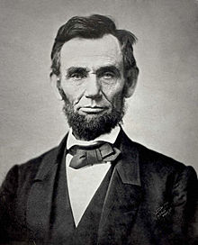
The History of Whistleblowing
During the Civil War, in response to the fraudulant activies (from both the North and South), Congress passed the United States False Claims Act (a.k.a. the “Lincoln Law”) on March 2, 1863
Passed under President Lincoln (hence the nickname- “Lincoln Law”
Allows ordinary citizens to sue companies on behalf of the government and be paid a percentage of the recovery

Slide 6
The History (cont.)
1863 United States False Claims Act
One of the first laws that protected whistleblowers
Tried to combat fraud by suppliers of the United States government during the Civil War
Encouraged whistleblowers by:
Promising them a percentage of the money recovered or damages won by the government
Protecting them from wrongful dismissal
Evolution of this law- changes were made in 1986, 2009, 2010; examples:
Increased fines for false claims
Redefined what a “claim” was
Increased the Attorney General’s power to intervene in these cases

Slide 7
State Laws Vary
Different states have different risks for whistleblowers based on their state law
17 states have very limited or no whistleblowing protection laws
Only 4 states protect all employees (government and private)
California
Louisiana
Massachusetts
Michigan

Slide 8
States With Very Limited/No Whistleblowing Protection Laws
Arizona
Arkansas
Washington D.C.
Georgia
Idaho
Maryland
Mississippi
Montana
Nevada
New Mexico
North Carolina
South Dakota
Texas
Vermont
Virginia
Wisconsin
Wyoming

Slide 9
Georgia’s Whistleblowing Act
AKA The “Act”
enacted in 1993
For purpose of eliminating fraud, waste, and abuse in state programs
Designed to protect those persons making complaints or disclosures from reprisals
It protects public employees who disclose an alleged violation of or non-compliance with any federal, state, or local law, rule or regulation to the possible existence of any activity constituting fraud, waste, and abuse in or relating to any state programs or operations
Any public employee who reports a potential violation shall be free from discipline or reprisal from his employer, unless such disclosure was made with false and reckless disregard
Notes:
-Basically it protects public employees who disclose a company’s problem with any law or rule to the possibility to any fraudulent activity
-any employee who reports a problem is immune from discipline from his employer unless it was made with false and reckless disregard

Slide 10
Laws & Ethics of Whistleblowing

Slide 11
What is a Public Employee?
“Any person who is employed by the executive, judicial, or legislative branch of the state or by any other department, board, bureau, commission, authority, or other agency of the State Personnel Administration and any local or regional governmental entity that receives any funds from the State of Georgia or any state agency.”
Notes:
-Any governmental worker in Georgia
-recently extended to nearly all Georgia cities, counties, and other local governmental entities
-does not apply to private companies

Slide 12
What is Retaliation?
“The discharge, suspension, or demotion by a public employer of a public employee or any other adverse employment action taken by a public employer against a public employee for disclosing a violation of or noncompliance with a law, rule, or regulation to either supervisor or government agency.”
Notes:
-taking any retaliatory action towards an employee because the employee disclosed a violation

Slide 13

Confidentiality
Under certain circumstances, Office of the State Inspector General (OIG) may be able to keep your identity confidential

Slide 14
Examples
American Recovery and Reinvestment Act (ARRA)
Gross mismanagement of an agency contract or grant relating to ARRA funds
Gross waste of ARRA funds
Substantial and specific danger to public health or safety related to the implementation or use of ARRA funds
Abuse of authority related to the implementation or use of ARRA funds
Violation of law, rule, or regulation related to an agency contract or grant awarded or issued relating to ARRA funds

Slide 15
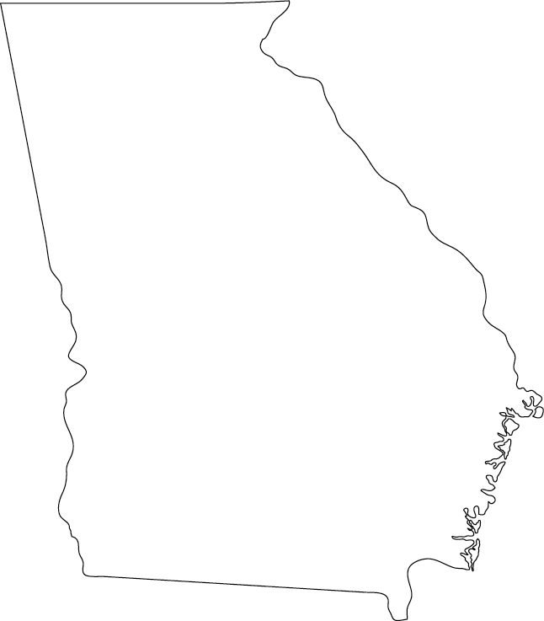
Where does Georgia rank?
Not a strong whistleblower law
49th out of 51 (50 states and District of Columbia)
Tied with Indiana but the worst state is South Dakota

Slide 16
Ethics of Whistleblowing
Altruistically motivated
Utilitarian
Allows own attitudes and beliefs to guide them
Loyalty to employer vs. moral commitment to the law and society
Notes:
Altruism – selflessness/acting for the concern and welfare of others
Utilitarian – act that maximizes happiness for most amount of people

Slide 17
Advantages
☺
You’re doing the right thing
You’re informing the public about a company’s wrongdoings
It will help the company
Notes:
Helping the company – problem can be corrected

Slide 18
Disadvantages
☹
If you live in a state with poor whistleblowing laws like Georgia, you could be fired, demoted, etc.
Loss of trust
Notes:
No one likes a tattletale and will lose peoples trust.

Slide 19
Snowden Case

Slide 20
Edward Snowden
29 year old, systems administrator working for NSA contractor
Released classified documents he believed the US public needed to see, including:
Verizon: secret court order to force the company to hand over phone records of millions of Americans
Prism: undisclosed program that gives NSA direct access to data held by Google, Facebook, Apple, and other big internet companies
Boundless Informant, GCHQ (UK equivalent of NSA), US judges signing off on orders, hacking Hong Kong and Chinese computers, etc.
Has been on the run since releasing the classified information and revealing his identity
Did interview with the Guardian in Hong Kong, who allowed him to leave, claiming US did not “fully comply with the legal requirements under Hong Kong law” and has no legal basis to prevent him leaving
Currently staying in an airport in Moscow, applying for temporary and permanent asylum in various countries

Slide 21
Legal implications
May meet the moral requirements for being a whistleblower, but not necessarily legal
Falls under the “Intelligent Community Whistleblower Protection Act”
Can only release information to two groups
an inspector general of a federal agency
a member of one of the congressional intelligence committees
Must report “urgent concern”: serious or flagrant problem, abuse, or violation of law
Going public is a possible violation of the Espionage Act
Not clear-cut evidence of illegality
NSA programs created under the Foreign Intelligence Surveillance Act and Patriot Act permit such surveillance
Whistle-blower laws have a blind spot when actions reported are controversial, but not exactly unlawful
YouTube clip: Video Clip

Slide 22
Aftermath
Leaks have created a major impact…
Debates over legality of NSA programs
Programs allegedly vital to national security; under new pressure to prove this
While, if caught, Snowden may go to jail or be prosecuted, he seems to believe that his actions are worth it, as long as the public does something to change how things are currently being run

Slide 23
Other Notable Cases

Slide 24
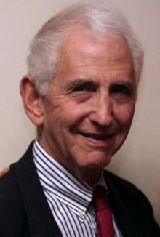
Daniel Ellsberg
Worked for the US Department of Defense from 1964 to 1967
Worked on the Pentagon Papers, but did not approve of the plans
In 1969, he began to photocopy the entire document with the help of a former colleague
Leaked the documents to different congressmen, none who were interested in going public with the material
Released the papers to the New York Times
When the NY Times was hit with an injunction, Ellsberg released the documents to 15 other newspapers
New York Times vs. the United States
6-3 decision authorizing the newspapers to print the Pentagon Papers without risk of government censure

Slide 25
Life as a Whistle Blower
Ellsberg was charged with theft, conspiracy, and violations of the Espionage Act
Charges were dropped when the Court discovered the Nixon Administration tried to blackmail him
Today, he is an active scholar and antiwar, antinuclear weapons activist
Written many books and articles on the subjects
Constantly active in the media as governmental issues arise
Has received many awards
In 2006, he received the Right Livelihood Award aka the “Alternative Nobel Prize” for “putting peace and truth first, at considerable personal risk, and dedicating his life to inspiring others to follow his example”
Many have come to regard him as a hero of uncommon bravery, a man who risked his career and even his personal freedom to help expose the deception of his own government in carrying out the Vietnam War
Ellsberg remains fiercely proud of his decision to leak the Pentagon Papers

Slide 26
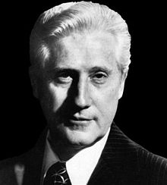
W. Mark Felt aka “Deep Throat”
Second in command at the Federal Bureau's Inspection division
Watergate occurred in 1972
Two days after Watergate occurred, he leaked information under the name "Deep Throat" to the Washington Post confirming that President Nixon and Howard Hunt were indeed involved in the Watergate Scandal
Denied being a whistleblower for 30 years
Came public in 2005 in a Vanity Fair issue revealing his identity as “Deep Throat” at age 91

Slide 27
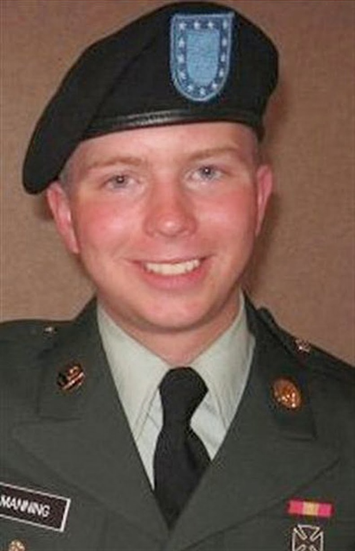
Bradley Manning
American soldier from 2008 to 2010
Responsible for the largest leak of cached classified information in the history of the United States
Leaked over 700,000 files
Began releasing classified material to Wikilinks in 2010, a website that an international, online, non-profit organization which publishes secret information, news leaks, and classified media from anonymous sources
Arrested in 2011 and charged with 22 offenses, including the capital offense of "aiding the enemy"
Manning has pleaded guilty to 10 out of the 21 charges
Faces a maximum sentence of life in military jail plus 154 years, on top of up to 20 years in custody for the charges to which he has already pleaded guilty.
Trial began June 3, 2013 and is currently awaiting a verdict

Slide 28
Public Reaction
Some people are calling him " the most important whistleblower since Daniel Ellsberg leaked the Pentagon Papers in 1971"
Many governments have blocked access to WikiLinks over the past few years
Many organizations have ended relationships with WikiLinks
Banks terminated accounts with WikiLinks and people associated with WikiLinks or froze their assets
Facebook deleted its fan page
Mastercard took action to prevent WikiLinks from accepting MasterCard-branded products
Apple removed the WikiLinks app form the App store
WikiLinks has also won many award over the years despite the criticism
Many celebrities have spoken out for the release of Bradley Manning

Slide 29
Sources
https://en.wikipedia.org/wiki/Whistleblower#Common_reactions
http://en.wikipedia.org/wiki/False_Claims_Act#2009_changes
http://www.ncsl.org/issues-research/labor/state-whistleblower-laws.aspx
http://www.dol.gov/compliance/laws/comp-whistleblower.htm
http://stimulus.georgia.gov/sites/stimulus.georgia.gov/files/related_files/site_page/WhistleblowerProtection.pdf
http://www.envoynews.com/elarbee/e_article001318313.cfm?x=b11,0,w
http://www.peer.org/assets/docs/wbp2/ga.pdf
http://www.expolink.co.uk/2012/01/ethics-and-whistleblowing/
http://www.csmonitor.com/USA/Justice/2013/0614/Edward-Snowden-Whistle-blowing-protections-most-likely-won-t-help
http://www.guardian.co.uk/world/video/2013/jun/09/nsa-whistleblower-edward-snowden-interview-video
http://www.guardian.co.uk/world/video/2013/jul/08/edward-snowden-video-interview
http://www.guardian.co.uk/world/the-nsa-files
http://www.guardian.co.uk/world/2013/jun/23/edward-snowden-nsa-files-timeline
http://www.csmonitor.com/USA/2013/0609/Edward-Snowden-NSA-leaker-reveals-himself-expects-retribution
http://www.csmonitor.com/USA/DC-Decoder/Decoder-Wire/2013/0610/Edward-Snowden-How-much-trouble-is-he-in-for-leaks-of-NSA-snooping

Slide 30
Questions?

