Slide 1


Slide 2

History of Sustainability at Wal-Mart
Lee Scott, predecessor of current Wal-Mart CEO Mike Duke, delivered his “Twenty First Century Leadership” address on October 24, 2005
Scott introduced three sustainability goals:
To be supplied 100% by renewable energy
To create zero waste
To sell products that sustain our resources and environment

Slide 3
To be Supplied 100% by Renewable Energy
Direct renewable energy efforts
Buildings
Develop a store prototype that is 25%-30% more efficient by 2009
Truck fleet
Increase fleet efficiency by 25% by 2009, and double fleet efficiency by 2015
Greenhouse gas emissions
Reduce total greenhouse gas emissions worldwide by 20% from the 2005 baseline by 2012

Slide 4
Direct Renewable Energy Efforts
Wal-Mart has more than 180 renewable energy projects in operation or development around the world
Largest onsite provider of “green” power in the U.S., with projects providing enough electricity to power more than 78,000 American homes annually
150 solar installations in seven countries
26 fuel cell installations in the U.S.
348 stores in Mexico are supplied by wind power

Slide 5
Buildings
Installation of LED lighting in freezer cases, parking lots, and sales floors
Secondary loop refrigeration
Can cut refrigerant-related emissions by as much as 95%
Fly ash flooring
Every ton of fly ash used in the cement flooring mixtures of new stores saves the equivalent of one barrel of imported oil

Slide 6
Truck Fleet
Since 2007, the Wal-Mart fleet has delivered 361 million cases while driving 287 million fewer miles
Increased number of pallets per trailer
Better route management
Introduction of hybrid assist and wheel-end hybrid assist technology
Aerodynamic skirting
Addition of Auxiliary Power Units to all trucks

Slide 7
Greenhouse Gas Emissions
In February 2010, announced new goal of eliminating 20 million tons of greenhouse gases from their global supply chain by 2015
Focus on products with highest levels of embedded carbon and reduce GHG emissions in either the sourcing of raw materials, manufacturing, transportation, customer use, or end-of-life disposal
Secondary loop refrigeration system
Sustainable palm oil and beef production

Slide 8
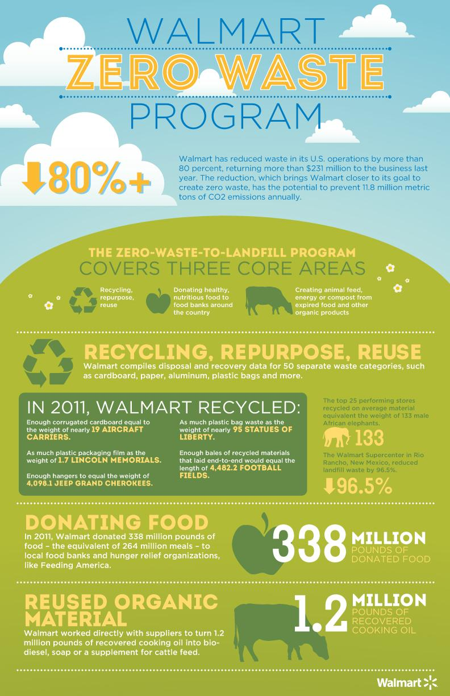

Slide 10

Super Sandwich Bale at Store Locations
32 different items
Walmart alone redirected from landfills
1.3 million pounds of aluminum
11.6 million pounds of mixed paper
18.9 million pounds of plastic hangers
120 million pounds of plastic
4.6 billion pounds of cardboard

Slide 11

Styrofoam Recycling Process
Delivered to Easter Seals Workforce Development Center where the air is squeezed out and created into dense brincks of styrene
Delivered to a picture frame company which uses recycled plastics
Picture Frame is sold in stores

Slide 12
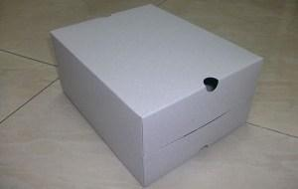

Packaging Reductions
In 2011, Walmart eliminated more than 1 billion feet of wire ties from our toy packaging – enough to wrap around the earth nearly 8 times.
Redesigned shoe box uses a single source of paper, fits multiple pairs of shoes and serves as a protective barrier during shipping -- while using 43% less paper and reducing costs by 28%.

Slide 13
Donating food to Feed America
Donated Refrigerated trucks
Doubled the number of meals delivered to 200 million
Accelerated development of commercial composting facilities
Donates Composted organic waste to wild animal parks

Slide 14
Electronics
Samsung Direct program
nominal fee other brands
CExchange
earn a eGift card for responsibly trading in electronics
ecoNew
trade in item on a negotiated value and receive a gift card

Slide 15
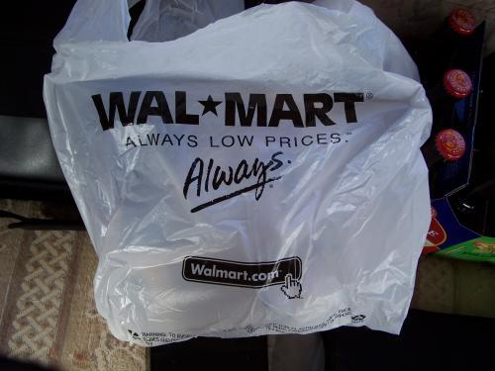
Plastic Bags
35% reduction per store
33% globally by 2013
Brazil Incentive Program
$1.1 million in rebates for using a reusable bag

Slide 16


To sell products that sustain people and the environment.
Sustainable Agriculture
Sustainability Index
Sustainable Seafood
Fair Trade

Slide 17
Sustainable Agriculture
Walmart hopes to
Form direct partnerships between farmers and markets
Reduce food waste
Motivate farmers to optimize production of key agricultural goods

Slide 18
Supporting Farmers
Train farmers and farm staff in crop selection and sustainable farming
Increase the income of smaller scale farmers by 10- 15%
Double sales of locally grown produce in the US
Progress: 97% increase in locally sourced produce in 2011

Slide 19
Produce More with Less
Invest more than $1 billion dollars to improving the efficiency of global fresh supply chain
Reduce the amount of wasted foods in stores by 15%
Progress: $167 million had been invested by 2012

Slide 20
Source Key Agriculture
Require sustainably sourced palm oil to be used in all Walmart brand goods by 2015
Require that all of Walmart’s seafood suppliers are third party certified
Progress: No disclosure of information regarding palm oil; 76% of seafood suppliers were third party certified as of February 2012

Slide 21
Sustainability Index
Providing information to consumers so they understand the production process of a good and how that process affects the environment
Viewing the supply chain as a whole to find ways to cut back on the use of natural resources

Slide 22
The Sustainability Consortium
Improve the sustainability of the products
Integrate sustainability into their core business techniques
Reducing the cost by improving efficiency of the supply chain
Strengthening consumer trust
Progress: In 2011, only 6 product categories were covered. Now, 190 product categories are analyzed.

Slide 23

Sustainable Seafood
Walmart US requires all of their seafood suppliers to be third party certified by the Marine Stewardship Council, Best Aquaculture Practices, or equivalent standards
Progress: By February 2012, 76% of their suppliers were third party certified and 8% were in the process of becoming certified.

Slide 24

Fair Trade
“Better for People, Better for the Environment”
Fair Trade Principles: empowerment, economic development, social responsibility, environmental stewardship
“Fair trade is the bridge that makes this powerful partnership possible” -Paul Rice, CEO and President of Fair Trade USA

Slide 25


Slide 26



Why green, why now?
Walmart stock was low in 2005
CEO Lee Scott believed in building a sustainable Walmart
The “greenwashing” PR campaign

Slide 27
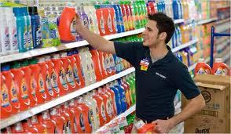
Greenwashing is good PR
Disapproval down to mid 20% from high 30%
Walmart quickly realized that cutting waste saved money in overhead costs
Product redesign

Slide 28
Sustainable in 2013?
Food and Water Watch Institute for Local Self Reliance put together a top 10 list of reasons that Walmart fails at sustainability.
1. Selling Shoddy Products
2. Reducing Waste According to who?
3. Lagging on Renewable Energy

Slide 29
The Top 10 Failures in Sustainability
4. Increasing Greenhouse Gases
5. Voraciously Consuming Land
6. Financing Anti-Environment Candidates
7. Consolidating and Industrializing
Food Production

Slide 30
The Top 10 Failures in Sustainability
8. Redefining Local
9. Degrading Organic
10. Spreading Poverty

Slide 31
Walmart: Sustainable System or Money-Hungry Monster?
Both
Is Mike Duke to blame?
Is the greenwashing campaign
to blame?

