Slide 1

Walmart Case Study
By: Rees Curtis, Jeffrey Christian, David Kim, Jenna Zivalich

Slide 2
Intro...
What is CSR?
  the responsibility of enterprises for their impacts on society
No governmental regulation regarding CSR or business best practices in US
Codes of conduct
Multilayered concept that consists of 4 interrelated aspects: economic, legal, ethical, & philanthropic responsibilities
Notes:
3rd bullet point: instead of gov regulation companies have marked tendency to use codes of conduct: set of rules outlining responsibilities of or proper practices of individual corporations
PYRAMID of dimensions of CSR
economic: companies created to provide goods and services to the public and to make a profit...
foundation for other 3 responsibilities
legal responsibilities: second layer
Ethical responsibilities practices that have not been codified into the law...societal members expect a company to do what is right and fair...
top of pyramid: philanthropic: businesses have responsibility and expectation to be good corporate citizens and improve quality of life

Slide 3
Walmart's Profile
largest general employer in the US as well as being world's largest retailer
2.2 million associates worldwide
net sales: $443 billion in fiscal year of 2012
more than 10,130 retail units under 69 different banners in 27 countries
Founded in 1962- Walmart discount store in Rogers, Arkansas
1969- Wal-Mart Stores, Inc.
1970- began trading on OTC markets
1972- listed on NYSE
Notes:
otc: over the counter markets: TRADING OCCURS VIA A NETWORK OF MIDDLEMEN CALLED DEALERS WHO CARRY INVENTORIES OF SECURITIES TO FACILITATE THE BUY AND SELL ORDERS OF INVESTORS
NYSE: New york stock exchange: order matchmaking service seen in specialist exchanges

Slide 4
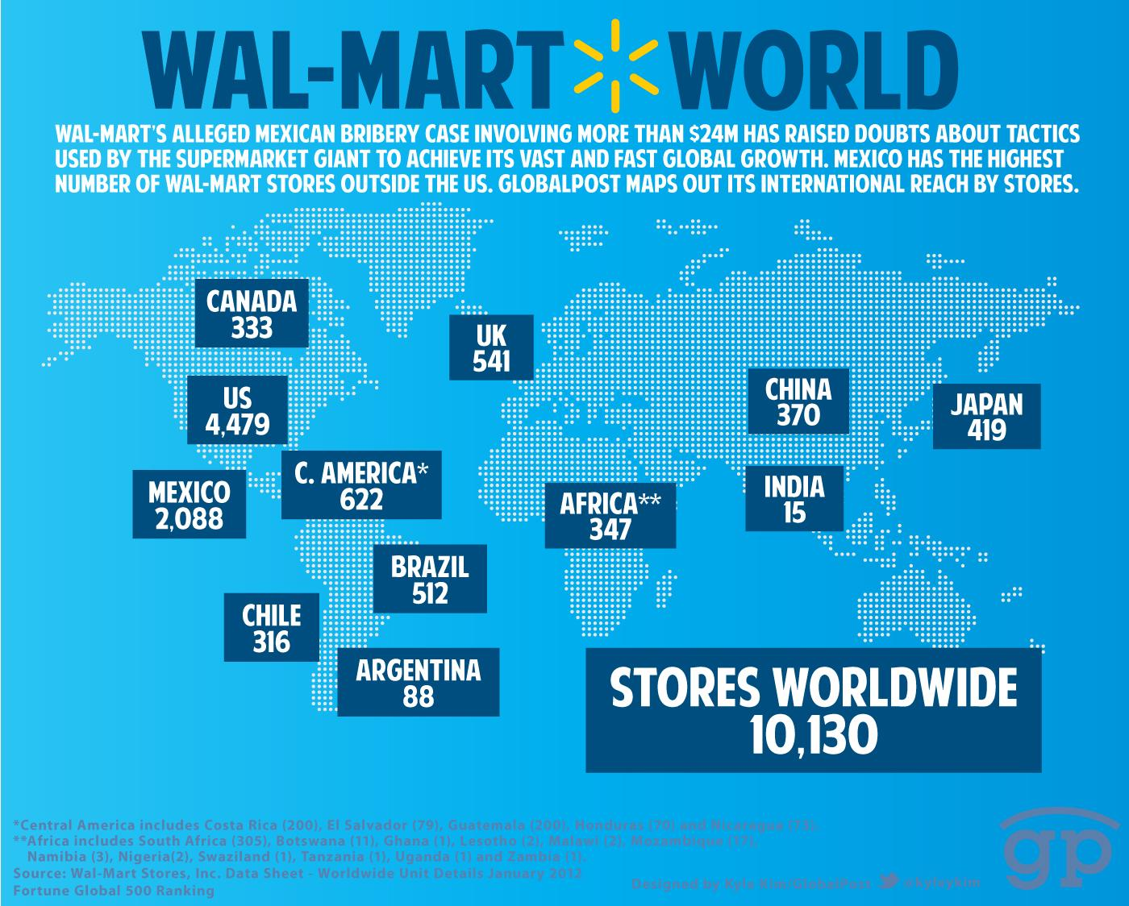

Slide 5
Troubles with CSR...
Walmart faced many obstacles over the year
development of its code of conduct and annual reporting
illustrated in two cases:
  Walmart Stores Inc v. Dukes et al
  Child labor scandal in Bangladesh
Notes:
legal and social challenges they have faced over the years have caused them to develop its code of conduct and annual reporting

Slide 6
Walmart CSR Policies
Walmart is referred in the CSR field as a "Global Legislator"
  They use contractual relationships to regulate global suppliers
Walmart publishes its own Global Responsibility Report annually
  Three parameters: Environment, Social, and Goals.
Walmart's performance, policies, and financial figures portray it as a model company on CSR
  Financial investments: education, health, fighting hunger, local farmer's support, and affordable food

Slide 7
Walmart Stores Inc. v Dukes et al
National class action suit against Walmart
Plaintiffs alleged that female employees were discriminated against based on gender
Civil Rights Act of 1964
  Discriminated against regarding pay and promotions to top management positions
Walmart appealed, arguing that the seven lead plaintiffs were not typical of the class
In 2010, the Supreme Court ruled to reverse the class certification

Slide 8
Walmart Stores Inc. v Dukes et al
The Supreme Court concluded that the plaintiffs did not have enough in common
The case would have comprised of all female Walmart employees post 1998
  Estimated to be 1.5 million women
  Would have been the largest class action lawsuit in US History
In 2011, the plaintiffs amended the lawsuit to only comprise of female employees in California
  This will lead to additional lawsuits at the state or regional level

Slide 9
Walmart Caught Using Child Labor in Bangladesh
In 2005, a radio program made news that Walmart was using children ages 10-14 in two Bangladesh factories
Children made less than $50 a month
Products from the factories were exported to Canada

Slide 10
Walmart Caught Using Child Labor in Bangladesh
Walmart's policy at the time was to stop business with suppliers when violations occurred
NGO Maquila Solidarity Network said "cutting and running" is the worst response
  It may discourage workers from telling the truth or encourage suppliers to subcontract work to avoid inspection
Walmart stopped doing business with the two factories right away

Slide 11
Post-Conflicts

Slide 12
Report on Ethical Sourcing
First released in 2005
Outlined Walmart ending business with 141 factories
  Mostly due to Underage Labor Violations
"Standard for Suppliers" placed 14 as the age minimum for suppliers
Specifically states non-discrimination policies

Slide 13
Changing the game
Changes in policy from lawsuits led the way
Walmart regarded as a "Global Legislator"
Changes in underage labor policies
  Strict corporate policy that was difficult to implement in developing countries.

Slide 14
Leading the Way
Annual Global Responsibility Report
  Triple Bottom Line and the Three P's
  Focus on Gender Equality and a Diverse Workplace
Gender Equality and Diversity policies in report.
Advisory Board on Gender Equality and Diversity for equal and enhanced opportunities.
  Increase in more than 1,000 female officials and managers from 2005-2010

Slide 15
Changes in CSR and Policy
2005, Walmart released Report on Ethical Sourcing
  Same time as Canadian Radio Station released information on Bangladesh
  Led to underage labor policy changes
More gender focused as lawsuit with Dukes et al continues
  Making numbers appear how they want
Changes for the wrong reasons?

Slide 16
Any Questions?

