Slide 1
United States v. Jones
Presented by: Rebecca Son

Slide 2
United States v. Jones
A Supreme Court case where the Court held that installing a GPS tracking device on a vehicle and using it to monitor vehicle movements constitutes a search under the Fourth Amendment

Slide 3
Fourth Amendment
Protects the…
“right of the people to be secure in their persons, houses, papers, and effects, against unreasonable searches and seizures.”

Slide 4
Story
Antoine Jones owns a nightclub in District of Columbia
Police began investigating for narcotics violations and installed a Global Positioning System (GPS) device on Jones’s Jeep Grand Cherokee without a valid warrant

Slide 5
Story
“The warrant authorized installation in the District of Columbia and within 10 days, but agents installed the device on the 11th day and in Maryland. The Government then tracked the vehicle’s movements for 28 days.”
Notes:
-used it to track device on Jeep Grand Cherokee registered under Jones’s wife

Slide 6
Story
Government obtained a multiple-count indictment charging Jones and several alleged conspirators with conspiracy to distribute and possess with intent to distribute five kilograms or more of cocaine and 50 grams or more of cocaine base
Jones filed a motion
The United States Court of Appeals reversed the conviction
Government petition for secondary appeal was denied
In 2011, writ of certiorari was granted
Notes:
-DC Court:
--Jones filed a motion to suppress evidence before trial but the District Court granted the motion only in part
--Court replied only parts of the vehicle movement because public transportation areas were okay
--Decision-guilty of possession and intent to sell cocaine… 97 kg cocaine 1 kg co. base, $850,000 in cash, decide to have life in prison

Slide 7
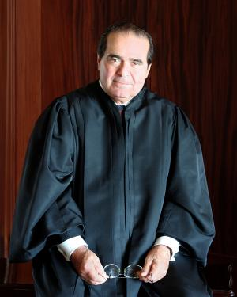
Majority Opinion
Associate Justice Antonin Scalia with four other justices – Roberts, Thomas, Kennedy, Sotomayor
GPS device was a trespass on private property and it constitutes a search
The Fourth Amendment, at a minimum, protects from trespassory government searches
Referred to the Katz v. United States and United States v. Knotts

Slide 8
United States v. Knotts
Case about surveillance beepers
Not a violation of Fourth Amendment
“We accordingly held in Knotts that ‘[a] person traveling in an automobile on public thorough-fares has no reasonable expectation of privacy in his movements from one place to another.’”

Slide 9
Katz v. United States
Charles Katz used a phone booth to talk about gambling
Violation of Fourth Amendment
“Reasonable expectation of privacy”
“What we apply is an 18th-century guarantee against unreasonable searches, which we believe must provide at a minimum the degree of protection it afforded when it was adopted. The concurrence does not share that belief. It would apply exclusively Katz’s reasonable-expectation-of-privacy test, even when that eliminates rights that previously existed.”

Slide 10
Conclusion
“…even if the attachment and use of the device was a search, it was reasonable – and thus lawful – under the Fourth Amendment…”
A trespass on private property, therefore, constitutes a search

Slide 11
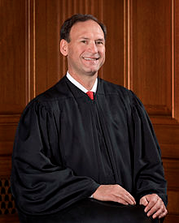
Concurring Opinion
Associate Justice Samuel Alito with three other justices argued that a long term GPS monitoring constitutes a search
Short term GPS monitoring might not violate a person’s reasonable expectation of privacy
Notes:
-short term GPS is okay because Knotts was short distance

Slide 12
Conclusion
“Disharmony with a substantial body of existing case law is only one of the problems with the Court’s approach in this case.”
“In circumstances involving dramatic technological change, the best solution of privacy concerns may be legislative.”
Notes:
Court cases should follow precedence.

Slide 13
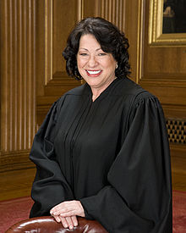
Concurring Opinion
Associate Justice Sonia Sotomayor said that the GPS was still installed without an active warrant
Agrees with Alito that a long term monitoring is not okay but questioned further on short term monitoring
Notes:
-long term monitoring in investigations of most offenses impinges on expectations of privacy
-short term surveillance still invades privacy because it can tell where you go

Slide 14
Conclusion
“I join the Court’s opinion because I agree that a search within the meaning of the Fourth Amendment occurs, at a minimum, ‘[w]here, as here, the Government obtains information by physically intruding on a constitutionally protected area’”
Short term surveillance can reveal the individual’s whereabouts
Became the decisive opinion

Slide 15
Conclusion of United States v. Jones
Supreme Court remanded the case to the district court
Jones accepted a plea bargain of 15 years, starting 2013

