Slide 1
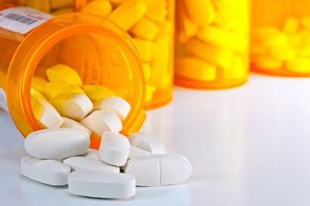
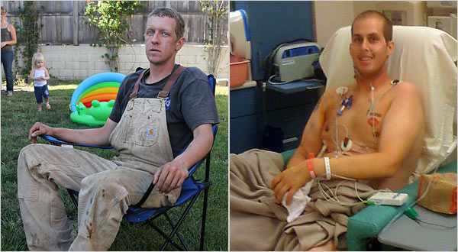
Two Cousins, Two Paths
Kristen, Simran, Chamberlynn, and Madison

Slide 2
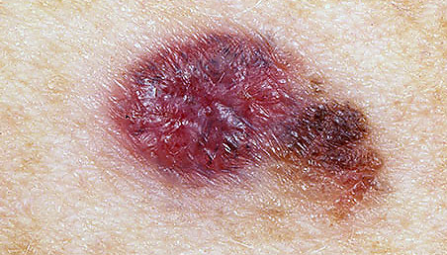
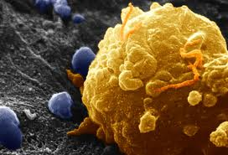
Background Info: Melanoma
Most lethal form of skin cancer
In 2010 it was the 6th most common cancer, now it is the #1 most common
Fastest growing cancer world wide

Slide 3
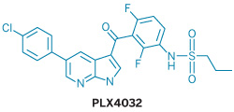
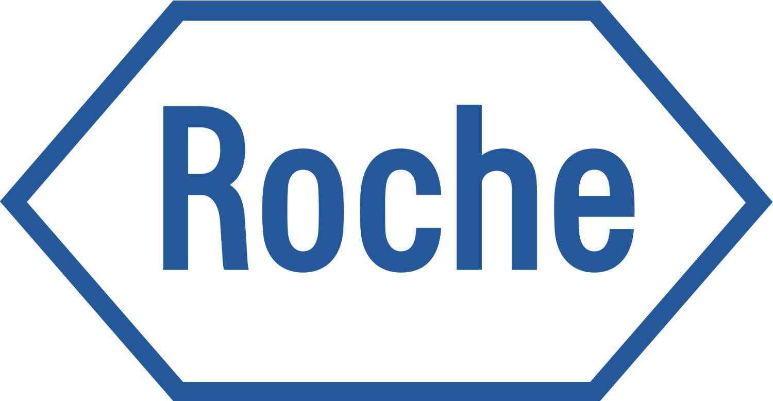
Background Info: PLX4032
Late-stage melanoma drug
Produced by Roche
Also known as Vemurafenib or Zelboraf
Works for B-RAF V600E gene
Approved by the FDA in 2011

Slide 4
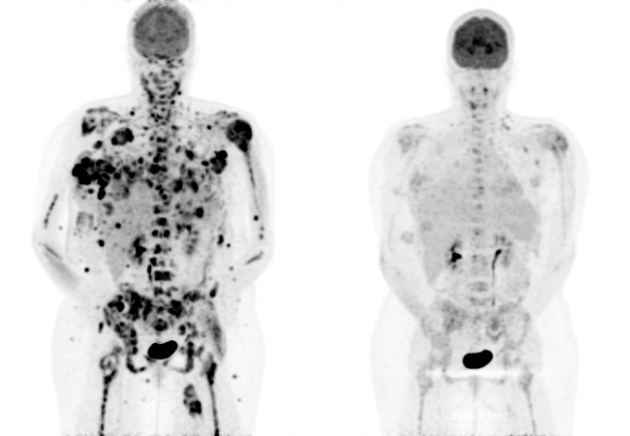
Background Info: PLX4032
What it does:
Inhibits growth and shrinks the tumors
Increases patient’s lifespan
Increases patient’s quality of life
Side effects:
Skin lesions
Arthralgia
Skin rashes
Photosensitivity

Slide 5
Clinical Trial
Used for tests in medical research and drug development
Control testing had 3 phases:
I: 80% regression for 2-18 months
II: similar to Phase I
III: PLX4032 versus Dacarbanzine (chemotherapy)
Costs $100 million
Doctors document all patient symptoms
Future: more trials for co-administering

Slide 6
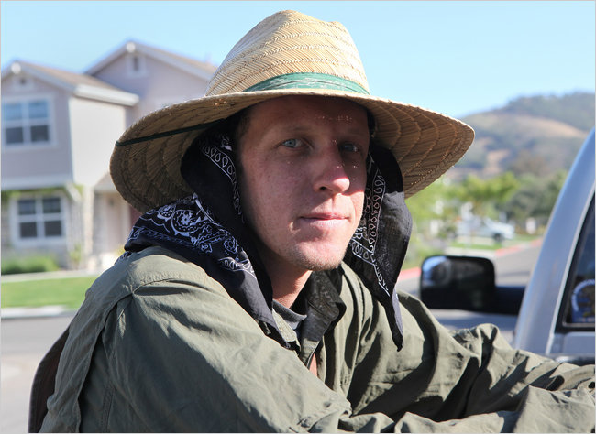
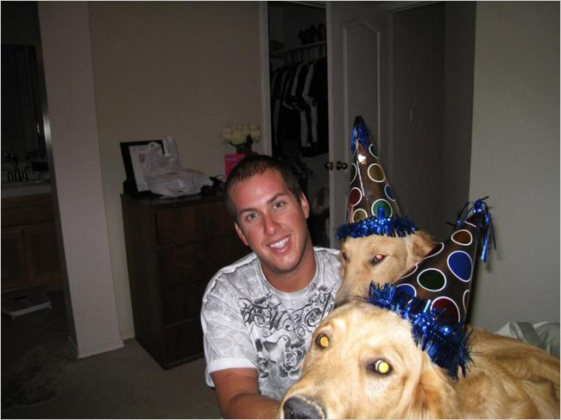
Patient’s Background
2 cousins from California were diagnosed with melanoma within months of each other in 2009
Thomas McLaughlin: 24
Brandon Ryan: 22
McLaughlin started trial testing first with the drug PLX4032
Ryan was denied treatment with the trial drug, instead he received infusions of chemotherapy
Ryan lost his battle less than a year after diagnosis

Slide 7
Mother’s Viewpoint
Felt completely hopeless, frantic to get the drug at any cost
Ethics of Care:
She was willing to do anything in her power to save her son
She felt compelled as a mother to protect her son and keeping him alive
“What gives them the right to play God?” - Mrs. Ryan

Slide 8
Two Sides to Every Story
Controlled trials have for decades been considered essential for proving a drug’s value before it can go to market
Doctors and researchers will not be able to see that a drug is truly working in prolonging life rather than just treatment without having a control group to compare with

Slide 9
Two Sides to Every Story
But critics of the trials argue that new science behind the drugs has eclipsed the old rules – and ethics – of testing them
Some drugs under development may be so much more effective that isolating patients into a control group causes needless suffering
Doctors admit that there is a conflict of interest between caring for their patients and gathering data for all of the future generations

Slide 10
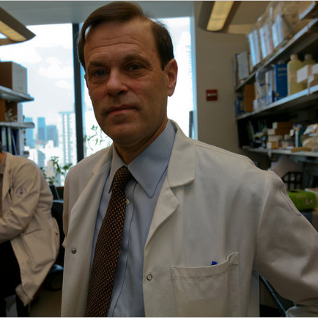
Ethical Dilemmas
Do No Harm, Promote Good, Equality and Right/Fairness
Kidder Case:
Individual v. Community
Short-Term v. Long-Term
Ends Based: Utilitarianism
greatest good for the greatest number
“My goal is to find out as quickly as possible in as few patients as possible whether this works. If we never know, then we’re never going to be able to build on anything.”
– Dr. Chapman

Slide 11
Reasoning Behind the Controls
Roche defends controlled trials because they provide hard proof, which is the bases on which the FDA decides approval
Together trial leader Dr. Chapman, Roche, and the FDA believe in benefiting the greatest number of lives in the long run
“I think we have to prove it, I think we have to show that we’re actually helping people in the long run”
– Dr. Chapman
Notes:
Ex: Dr. chapman had been involved 20 years prior in a case where bone marrow transplants were thought to help against breast cancer. Advocates were screaming for the approval for everyone, but after more controlled tests the transplants proved to do more harm than good
The FDA does approve compassion cases but Roche was concerned that many patients would enter the trail under chemo and then ask for a compassion case which would hinder and screw the comparison results between the control and test
The FDA also wouldn’t approve early release because they knew further testing would stop because they would loose trail patients who could be placed into the control group through the lottery. And then the drug would not receive as broad an approval therefore not helping as many people as possible

Slide 12
Any Questions?

