Slide 1
Case Study 8.2
Lauren Burns Sammy Eastwood
Brian Seo Chelsea Sizemore

Slide 2
Introduction
Mordidas - Spanish [noun]
- a bite, kickback
- (slang) a bribe to pay a public official, in return the official does not ticket an individual
The Mexican government has been working to combat corruption, with limited success.
Police officers are poorly paid; they make half their salary based off mordidas

Slide 3
Endemic Issue
From the Attorney General's office, the Treasury, to Mexican Customs, mordidas were so highly prevalent, customary
President Salinas De Gortari, 1988, first president to tackle mordidas, but failed

Slide 4
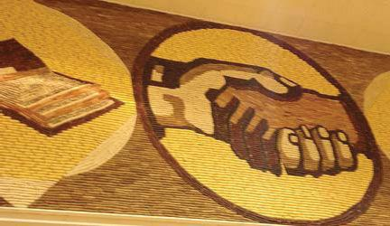
Mordidas = Bribes
This case study shows an excellent use of how bribes can be used in typical or normal jobs.
When, if ever, are bribes justifiable?
How can we rid our business systems of them?

Slide 5
Cultural Relativism
Cultural relativism-
The view that all beliefs, customs, and ethics are relative to an individual within their own social context or cultural environment.
"Right” and “wrong” are culture-specific.
There is no universal standard for morals.

Slide 6
Discourse Ethics
Step 1: Identify the immediate stakeholders - those who are most affected by the dilemma and can be gathered to solve it
Mordidas: In this example, the immediate stakeholders would be the police officer and the driver who has been pulled over.

Slide 7
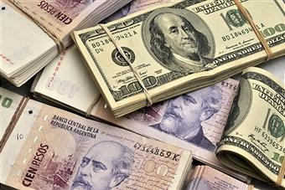
Discourse Ethics
Step 2: Establish a language for discussion
Mordidas: In this situation, the two stakeholders would be speaking in the language of money.

Slide 8
Discourse Ethics
Step 3: Establish the goal - in discourse ethics the goal is always the peaceful and consensual resolution to the dilemma.
Mordidas: The ideal goal would be that the driver is able to bribe the traffic cop into not giving him a ticket

Slide 9
Discourse Ethics
Step 4: Define the problem - this stage requires fairly lengthy elaborations by all those involved of exactly what they understand their obligations and interests to be
Mordidas: In this example, there is actually not a lengthy elaboration by the traffic cop or the driver; both understand what their obligations and interests are.

Slide 10
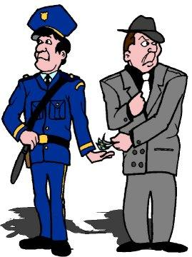
Discourse Ethics
Step 5: Propose Solutions
Mordidas: The driver slips the equivalent of five dollars into the traffic cop's codebook. The officer takes it and allows the driver to leave without writing him a ticket.

Slide 11
Corruption Perception Index
I think the informal agreements made by businessmen in Mexico is another example of discourse ethics because it follows all five steps.
Step 1: Stakeholders are the businessmen
Step 2: Language is money/deals/bribes
Step 3: Goal - make businessmen happy
Step 4: Businessmen have to express what they want from each other
Step 5: A solution is discussed

Slide 12
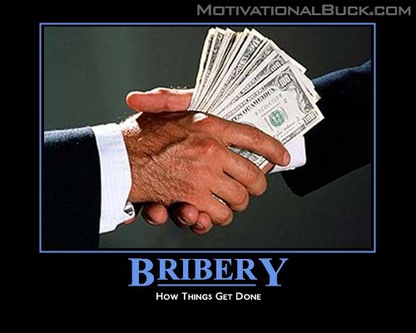
It seems that the other officers in his department are also friends of his and therefore he shares a common bond with them, creating a relationship of social responsibility.
He relates more closely to his fellow officers than to everyone in the surrounding community.

Slide 13
Ethics of Care
Making the nurturing of our immediate communities and the protecting of those closest to us the highest moral obligation

Slide 14
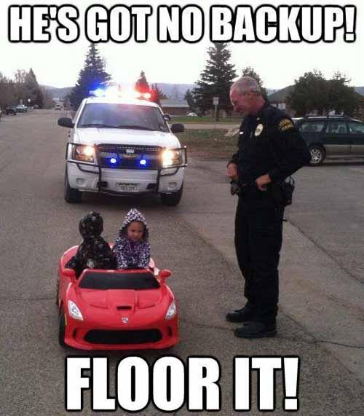
Scenario...
An officer pulls over his nephew and an out of towner who he has never met.
Would he treat them differently using ethics of care? If so, why?

Slide 15
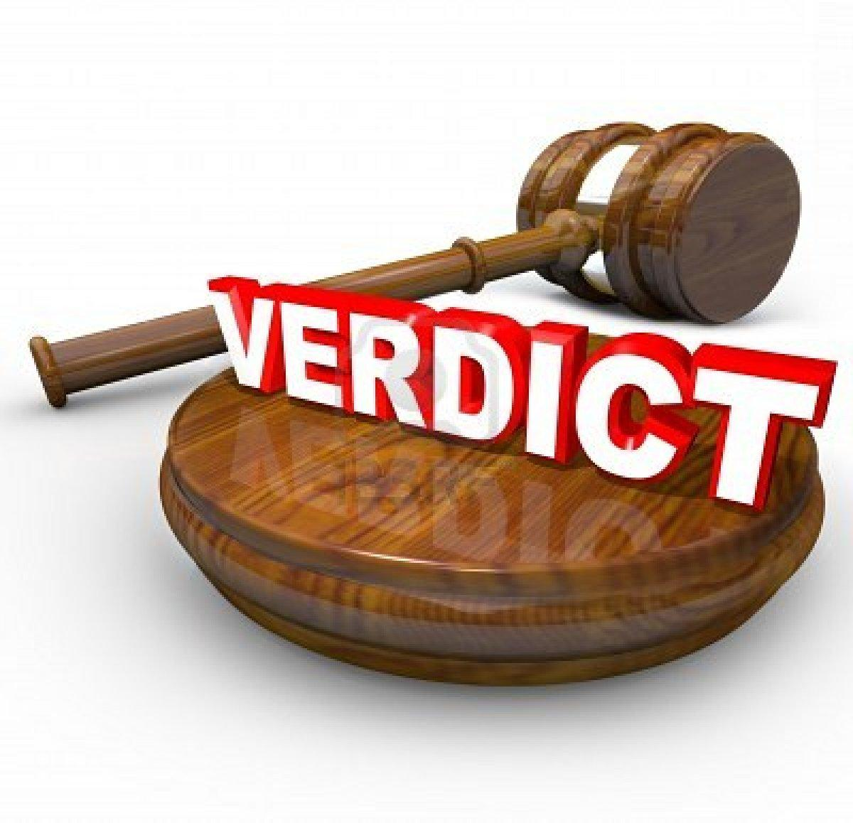
His nephew.
.....why?

Slide 16
Nephew Out of towner
- Has personal relationship and connection with him
- No relationship or connection with him

Slide 17
Treatment
Thus, it is easier to be harsher to the out of towner because the officer will not feel an effect of the out of towner emotions or actions after pulling him over. However, he probably sees his nephew a lot more, and would have to deal with family talking and other actions that will affect the officer’s personal life more.

Slide 18
Could there be other circumstances where he would treat his nephew more harshly?
He knows his nephew will always be his family, so he cannot be upset with him forever. Or if he did not like his nephew, he has a vindication against him, which could easily make the officer want more money from him.

Slide 19

Other examples of ethics of care
In elementary school when you had to write people’s names down for talking. You would be more lenient to yours friends rather than to the people you didn’t like.
http://www.youtube.com/watch?v=nF7H62Y6iio

Slide 20
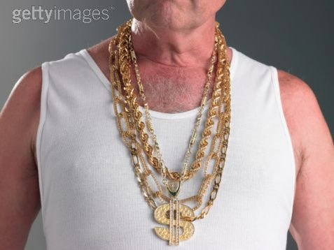
Web of Responsibility
The Police Officer cares for himself
He takes no thought
for other people
Stake holders:
Mayor, government officials
Police, Law enforcement officials
Citizens

Slide 21
Affected Individuals
Mayor, Government officials
held responsible for the city and its laws and regulations
with mordidas so prevalent and common, city ethics questioned
Law Enforcement officials
accustomed to mordidas - part of their expected income
played the system to benefit themselves
Citizens
knew inadvertently to the police traffic enforcement system

Slide 22
Ethics of Care
Stage | Goal
Pre-conventional | Stage 1: Obedience to authority Stage 2: Nice behavior in exchange for future favors
Conventional | Stage 3: Live up to others' expectations Stage 4: Follow rules to maintain social order
Post-conventional | Stage 5: Adhere to social contract when it is valid Stage 6: Personal moral system based on abstract principles

Slide 23
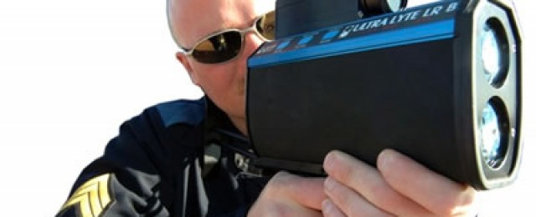
Mexican Police
Ethics of Care: Nephew and Stranger
Conventional - to treat them fairly
Post-conventional - based on familial, social contract

Slide 24
Ethics of Care
Normative theory
Questions what makes actions right or wrong
Ethics of care criticizes the applications of universal standards
Applied to benefit those with potential to benefit you in the future
Notes:
All individuals are interdependent for achieving their interests
Those particularly vulnerable to our choices and their outcomes deserve extra consideration to be measured according to
the level of their vulnerability to one's choices
the level of their affectedness by one's choices and no one else's
It is necessary to attend to the contextual details of the situation in order to safeguard and promote the actual specific interests of those involved

Slide 25
Perspective
200 injured and 20 deaths
Disbanding traffic tickets will not solve the problems
The Mayor taking out traffic violations effectively ended mordidas
Without traffic violations, more traffic related accidents rose in the lawless two months

Slide 26
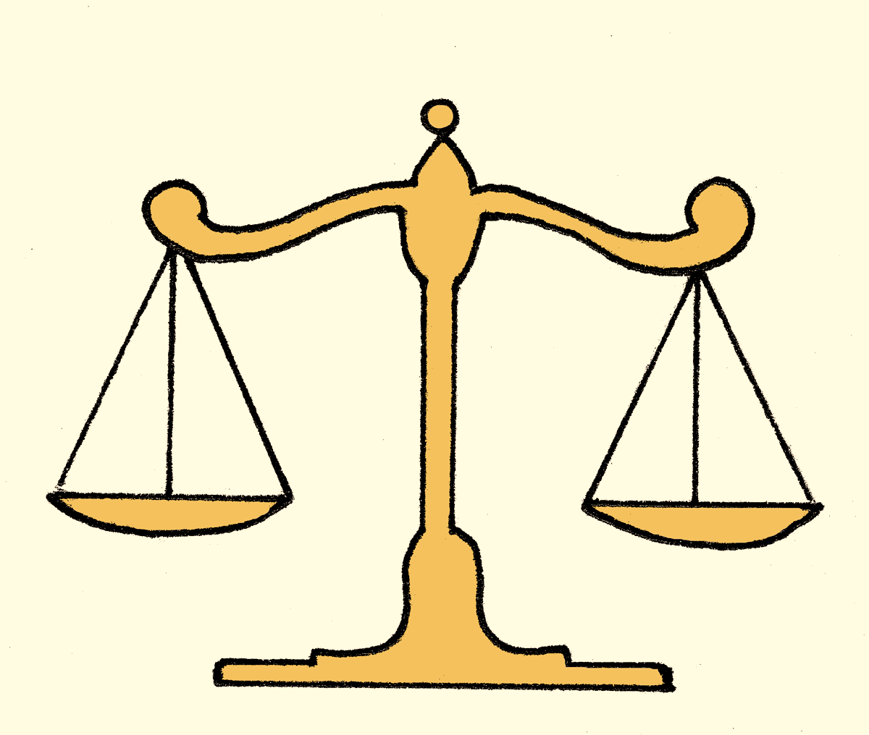
A Balance
The balance
Finding a solution to both the bribery and the enforcement of laws and regulations
Requires holistic approach, ethics of care, and scrutinous application of law and law enforcement

Slide 27
Thank You
Lauren Burns Sammy Eastwood
Brian Seo Chelsea Sizemore

