Slide 1
The Looting and Return of Art
By:
Greg Ehmer
Wesley Kean
Reid MacArthur
Bhargav Viradia

Slide 2
Outline
Introduction and history of Art Looting
Ethical dilemmas that surround the art market and returning artwork? What factors? What ethical codes?
Nazi Looting of WWII
Looted statues from the 1970’s Cambodian Civil War
Bodleian Library and the Portugal Books
British possession of the Indian Koh-i-Noor Diamond
Ethics behind returning artwork

Slide 3
Looted Art - Introduction
Looted art has been a consequence of looting during war, natural disaster and riot for centuries
Often revolves around artwork plundered by the German Nazi’s during WWII and the Holocaust Era 1933 - 1945
Interestingly, many of the world’s greatest artworks were taken from their rightful owners
Many ethical dilemmas arise pertaining to justifications for looting rights and artwork ownership

Slide 4
Looted Art - History
Art looting has a long history
The winning party of armed conflicts often plunder the loser
In the absence of social order, the local population often join in looting
Early Examples:
- Tombs of Pharaohs
- Rome Sackings
- Hernan Cortes
- Old Testament
Notes:
The contents of nearly all the tombs of the Pharaohs were already completely looted by grave robbers before the invasion of Egypt by Alexander the Great in 332 BCE.
There have been a total of 7 sackings of Rome from 390 BC with the Battle of the Allia to the 1527 Sacks of Rome by the mutinous troops of Holy Roman Emperor Charles V
Hernan Cortes’ sacking Mexico and looting of gold for Spain during the early 1500’s
Old testament has several examples of looting or art and treasure. For example, in the Book of Chronicles it says: "King Shishak of Egypt attacked Jerusalem and took away the treasures of the Lord's temple and of the royal palace

Slide 5
Ethical Dilemmas of Looting and Returning Art
Art market and ethical issues:
- art object itself
- behavior of art-market organizations
- collecting and ownership of art
Ethical circumstances for returning art?
- applying integrity, trust and professionalism
- business vs. right and wrong
Codes and Guidelines
- 1970 Unesco Convention
- 1986 International Council of Museums
Notes:
Regarding ethical issues in the art market, one must focus on those issues relating to the art object itself (the sourcing of materials, conservation and restoration, intellectual property), the behavior of art-market organizations (the relationship of museums to the art market, the operations of dealers and auction houses), and the collecting and ownership of art (questions of origin and ownership, inheritance and de-accessioning or removing artwork from gallery for funding)
There is no real clear cut solution to determining who has rights to artwork, which is why the dilemma is often resolved through negotiations. In these circumstances both parties must approach the situation with virtues of integrity, trust and professionalism to solve the problem in an ethical and sound manner
Many museums and galleries that receive profit from tourist attraction to artwork and would thus be reluctant to release artwork to who may be there rightful owners. But, many museums do in fact try to release the artworks to their rightful owners, showing the appreciation for art
Many of the art ethical codes and guidelines have been drafted in the spirit of a 1970 Unesco convention that prohibited the illicit circulation of a nation’s cultural property.
In 1986 the International Council of Museums adopted a code of professional ethics that insists on due diligence for every item entering a collection.

Slide 6
Nazi Stolen Art
Background:
Was the organized looting of the countries that the Nazis invaded.
Objects stolen range from paintings, ceramics, books, silver, and religious treasures from countries including Belgium, Netherlands, Poland, Soviet Union, and many others.
While most pieces were taken from museums, there were many pieces that were taken from family homes, especially Jewish families.
There are many cases where museums are refusing to return art that belonged to family's private collections such as the Rosenberg's.

Slide 7


Slide 8
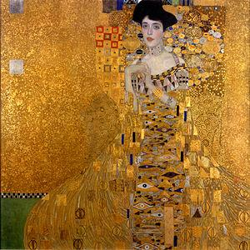

Slide 9
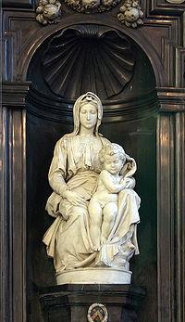

Slide 10
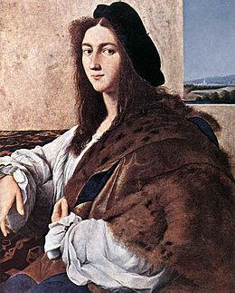

Slide 11
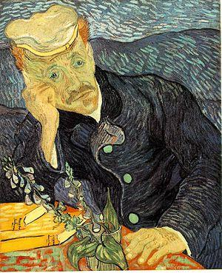

Slide 12


Slide 13
Cambodian Statues
Background:The statues from the 10th century had been "illicitly removed" from the Prasat Chen temple at Koh Ker during Cambodia's civil war in the early 1970s.
Statues from the temple scattered all around the world at various museums and private collections.
The Met in NYC returned the statues to Cambodia May 3rd, and Cambodia claims that the Norton Simon Museum in California, the Denver Art Museum and the Cleveland Museum of Art as each having one statue connected to Prasat Chen.

Slide 14
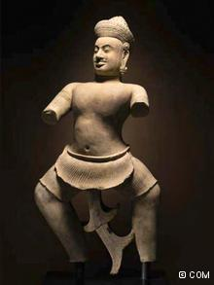

Slide 15


Slide 16

Bodleian library
Library of Oxford
university
Thomas Bodley offers to
restore the run down library at his own
expense in 1598
The Earl of Essex raided Faro donates books to Bodley, who is collecting for the Oxford library
65 titles and 91 volumes were certainly taken from the bishop´s collection in Faro because they bear the bishop´s arms stamped in gold on their covers

Slide 17
Conflict
Dorothy wrote to the President of the Algrave History association that the stolen books are currently in England should be returned to their former home in Faro.
However is clear that neither the establishment in England nor that in Portugal is concerned with this issue.

Slide 18
The 16th and 17th centuries – widespread political commotion and collections
Oxford´s library founded by Duke Humfrey.
Some of the works from the original library are now in St Petersburg and Rome.
“If we see these volumes as a part of a vast European collection, it cannot matter in which part of Europe they are located, if they are well cared for, and if their location is acknowledged and if they are available for consultation.”

Slide 19

Koh-i-noor

Slide 20
Law
UK’s long standing tradition of not wanting to return stolen goods.
Up until 2009 it had laws that prevented museums from returning looted Nazi art. It however allowed to compensate individuals who to prove their families’ ownership prior to or during the war.

Slide 21
Ethically Responsible
Are the museums ethically responsible for returning the art to the respectful owners and countries?
Yes
- Virtue ethics
- Altruism
- CSR

Slide 22
Ethically Responsible?
No
- Sotheby’s Auctions
- Consequentialist view
- Utilitarian view
- Ethics of care view

Slide 23
Ethical Outcomes of the Met’s Actions
Displayed Sense of CSR
Enlightened self interest
Similarity to Canon case

Slide 24
Nazi Stolen Art Video
http://www.youtube.com/watch?v=rakflQPOl44

