Slide 1

Life After Bars for the Innocent
Chamberlynn, Kristen, Madison, Simran

Slide 2

Wrongful Convictions
“Miscarriage of Justice”
The conviction of someone for a crime they did not commit
Civil or Criminal Cases
Types of Cases:
Homicide (most common)
Sexual Assault/Rape
Non-violent crimes
Robbery
Others
Convicted are not exonerated until it is too late

Slide 3

Wrongful Convictions
Types of Wrongful Convictions:
Type I: “False Positive”
Type II: “False Negative”
Reasons for Wrongful Convictions:
Misidentification
Lack of or errors with forensics & technology
Innocent Pleading Guilty
Contaminated Evidence
Prosecutorial Misconduct
Untruths:
Withholding/Destroying Evidence
Perjury
Editing Evidence

Slide 4
Wrongful Convictions
Convicted receive pardons
Death Penalty Argument
Have irreversible effects on a person
Statistics:
Average length of time behind bars 13.6 years
Average age at conviction 27
Estimated 8-12% of convicted persons are innocent
Estimated 2,000 – 5,000 wrongful convictions per year
DNA is vital to exoneration

Slide 5


Posing Questions
Should the wrongfully convicted expect financial compensation?
If so, who should compensate them?
How much is their lost time worth?

Slide 6

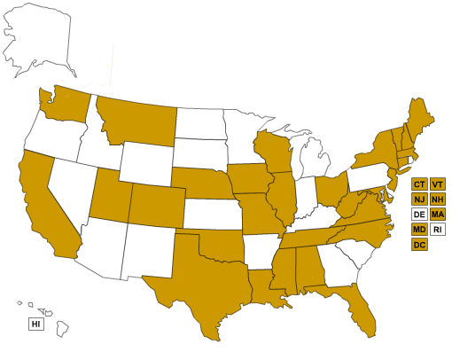
Compensation by the State
29 states and the District of Columbia have compensation statues - vary from state to state

Slide 7
Some Compensation Statutes
CA: max of $100/day or $36,500 yearly
FL: $50,000 a year with a max of $2,000,000
ME: max of $300,000
MA: max of $500,00
NY: no max amount
TN: max of $1,000,000
WI: $5,000 a year with a max of $25,000 plus attorney fees

Slide 8
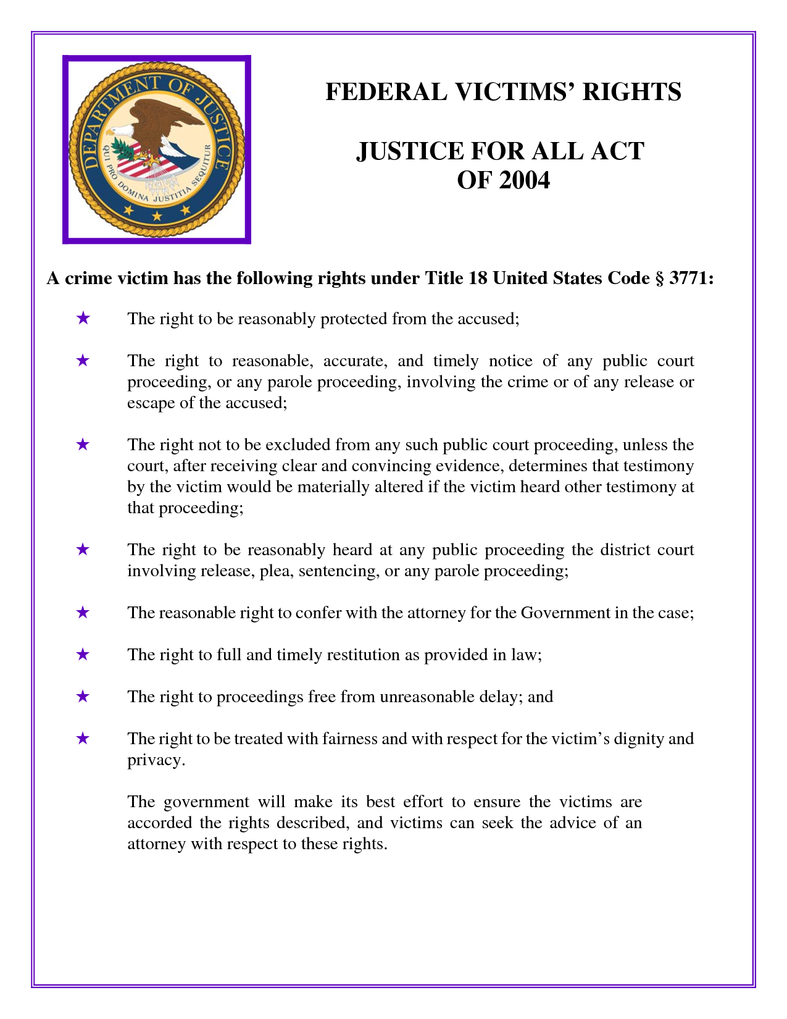
Federal Compensation
$50,000 a year for wrongful incarceration for a federal crime
Additional $50,000 a year if time served was on death row
Justice For All Act 2004
Innocence Protection Act

Slide 9

“The Innocence Project’s full-time staff attorneys and Cardozo clinic students provide direct representation or critical assistance in most of these cases. The Innocence Project’s groundbreaking use of DNA technology to free innocent people has provided irrefutable proof that wrongful convictions are not isolated or rare events but instead arise from systemic defects…”
A non-profit organization working closely with Cardozo School of Law at Yeshiva University
“…to free the staggering numbers of innocent people who remain incarcerated and to bring substantive reform to the system responsible for their unjust imprisonment.”

Slide 10
“Innocent Man Spent 17 Years in Prison” - CNN Clip
http://www.cnn.com/2012/03/25/justice/wrongful-conviction-payments

Slide 11

Exoneration Program
The Life After Exoneration Program is the only national organization dedicated to helping survivors of wrongful conviction re-enter society and rebuild their lives
The program receives no government funding
"Rebuilding the Lives of the Wrongfully Convicted"
Notes:
They help support exoneres from every state and also work with local programs

Slide 12
Challenges of Rebuilding:
Employment
Housing
1/2 have to live with family members
Financial Resources
2/3 are unable to be financially independent
Support Systems
1/3 lost custody of children as result of conviction
Access to medical, psychological and dental care
25% suffer from PTSD
Notes:
Prosecutorial misconduct

Slide 13
Ways the Program Helps:
Provide basic resources such as food, clothing, transportation, computers and emergency funds
Match exonerees with pro-bono legal service providers
Prosecutorial Misconduct
Maintain a peer network of exonerees
Lobby for legislative reform, support advocacy efforts, and develop model state policies outlining exoneree services

Slide 14
How the Program Survives:
Individual monetary contributions
In-Kind Donations
Computers
Gift cards to shopping malls & grocery stores
Skilled Volunteers
Database & internet research
Fundraising
Graphic design
Event coordination

Slide 15
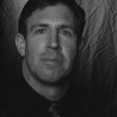
David Shawn Pope
Dallas County, TX
Sexual Assault Case
Sentence: 45 years
Served: 15 years
Released: 2001
Compensation as of 2012: $557,000

Slide 16
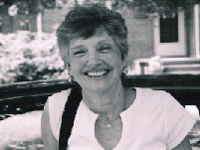
Beverly Monroe
Richmond, VA
Murder Case
Sentenced: 22 years
Served: 11 years
Released: 2002
No Compensation

Slide 17
Sources
www.exonerated.org
www.law.umich.edu
www.law.northwestern.edu
www.cnn.com
www.innocenceproject.com
www.edition.cnn.com
www.wikipedia.com
www.nytimes.com

