Slide 1
Gowanus Canal Superfund Site
By: Sarah Dixon, Sam Gratton, Paul Hutton, and Darrington Altenbern
July 29, 2013

Slide 2
Overview
Superfund site
Qualifications
Gowanus Canal: brief history
Progression of pollution
Solution Attempts
Pros for making it a Superfund
Cons against making it a Superfund
Flooding problems
Proposed Solutions
Conclusion
Notes:
darrington

Slide 3

What is a Superfund Site?
Common name for the Comprehensive Environmental Response Compensation and Liability Act of 1980
Gives the EPA authority to:
  Conduct removal actions
  Enforce against potentially responsible parties
  Ensure community involvement
  Involve states
  Ensure long-term protectiveness
Notes:
darrington

Slide 4
Qualifications
First step: Preliminary Assessment
Second Step: Site Inspection
  Hazard Ranking System score
    Minimum Score of 28.5, Gowanus Canal got a score of 50
  Three factors in finding Hazard Ranking score
    Likelihood that a site has released or has the potential to release hazardous substances in the environment
    Characteristics of the waste
    People or environments affected by the release
Notes:
darrington

Slide 5
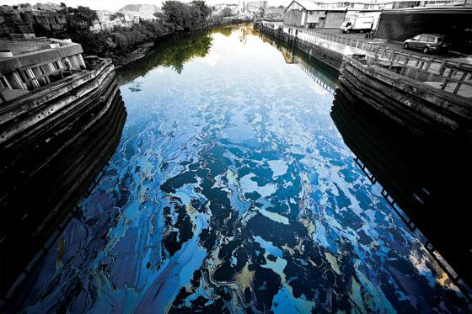
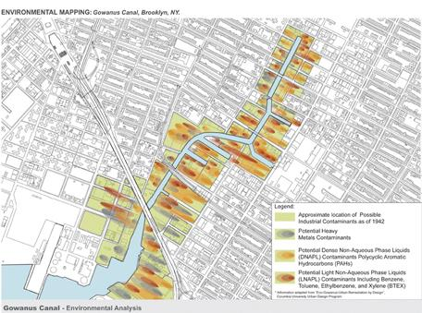
Background
Originally know as the Gowanus Creek
Built into a canal in 1869
Was used as a major cargo transportation hub
Located in New York City
  goes through Brooklyn
1.8 miles long
One of the most contaminated bodies of water in the nation
Notes:
Sam

Slide 6
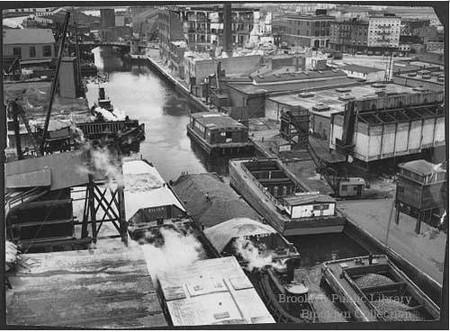
Progression of Pollution
Build with many design flaws
  no lock system but within budget
  only one side of canal is open
  no flushing of water
Industrial Revolution impacts
  gas plants, mills, tanneries, and chemical plants
Notes:
Sam

Slide 7
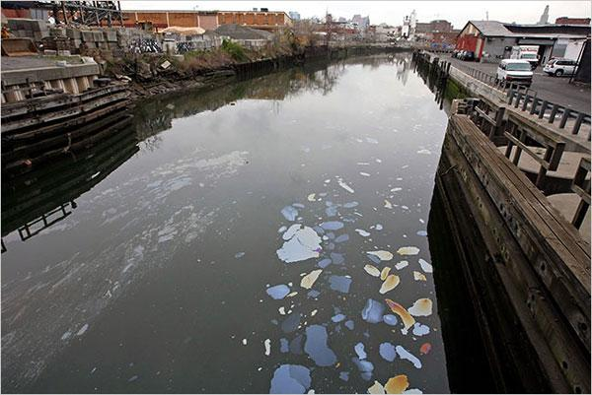
Progression of Pollution (contd.)
Chemical fertilizers
Extremely small amount of oxygen
  1.5 parts per million, minimum of 4 ppm
Obstruction of sunlight to only two feet deep
Major health risks to marine life and the community

Slide 8
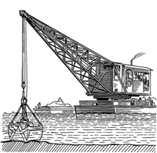
Solution Attempts
Regular scheduled dredging until 1955
Big Sewer in 1890s
Flushing Tunnel
Red Hook Water Pollution Control Plant
Notes:
Darrington
-Dredging done by US Army Corps of Engineers
-sewer would serve two purposes: to drain the flooded district, and to use the flow of that excessive water to move the water of the upper Gowanus Canal
-Headlines in the Brooklyn Daily Eagle newspaper declared it an engineering blunder shortly after its construction
-Flushing tunnel failed because of operational issues and a city worker dropped a Manhole cover onto the pump causing it to break
-didn't get fixed until 1999

Slide 9
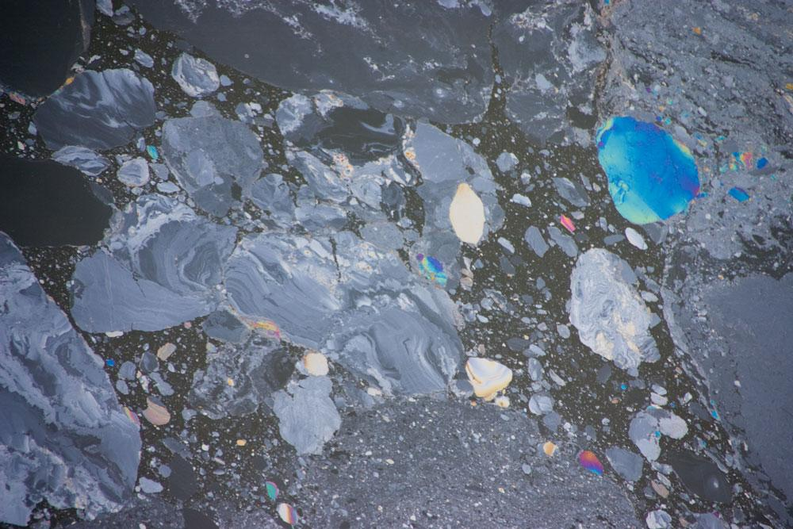
Pros - Make it a Superfund Site
Holds companies responsible
  Won't put cost on taxpayers
Most funded solution
Creates national awareness
Best possible solution for decontamination
  in the long run
Notes:
Sarah

Slide 10
Cons Against a Superfund Site
Length of time
City can not carry out private clean-up efforts
Most expensive solution
Possible lawsuits with companies
Negative connotations of a Superfund
Decrease in real estate values
  could put new developments on hold
Notes:
Sarah

Slide 11
Flooding Problems
Flood levels reached 3-4 feet
Waters went into people's homes
  property damage
  health concerns
Contaminated water flooded Tony Locane's basement
Notes:
paul

Slide 12
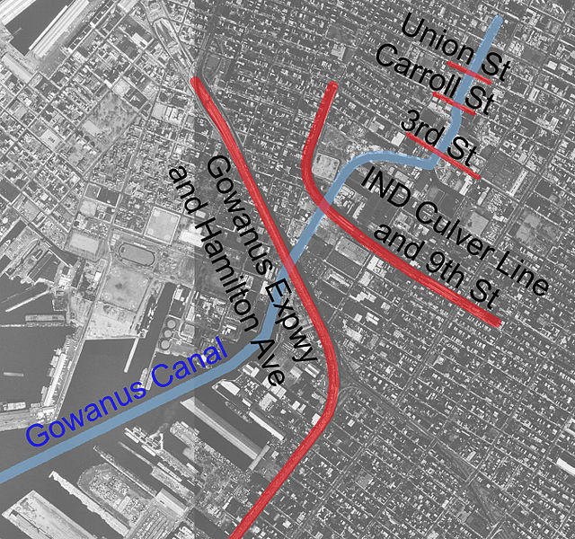
Proposed Solution
Dredging
Installation of caps
Repairing flushing tunnel
Notes:
Paul

Slide 13
Conclusion
The city waited too long to act
There are negative and positive connotations to the Superfund status
Although expensive, the process is necessary and vital to prevent more toxic flooding
Notes:
Paul

Slide 14
Questions?

