Slide 1

And its Privacy Policies
Diane Lin & Anna Adams

Slide 2
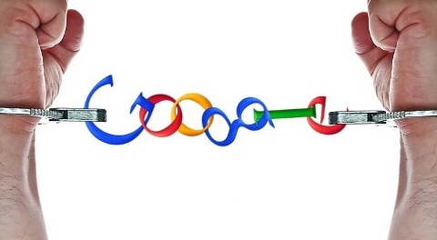
Not Just a Search Engine
“Internet-related services”
Androids
Chromebooks
YouTube
Motorola
Gmail
Drive
Maps
Wallet
Google Plus

Slide 3
Google’s New Privacy Policy
Previously:
The data collected from YouTube users was separate from other Google products
Same with search history (including possibly sensitive information)
The new privacy policy removes all boundaries among all of the facets of Google
“Single-user treatment”
Very vague overview on the FAQ when it first came out
“Beautifully simple, intuitive user experience”
Congressional intervention

Slide 4

Google’s Privacy Policy Today
The more information they have, the more personalized and tailored their services can be
Cookies
Remembering passwords
Facial recognition
Customized settings
“When you share information with us…we can make those services even better.”

Slide 5
What They Know
Information Google collects
Information you give them
Name, email, telephone number, credit card number
Information collected from used services
Device Info: Hardware model, operating system version
Log Info: search queries, telephone log, cookies
Location Info: GPS signals, WIFI access points
Unique Application Numbers: automatic updates
Local Storage: browser web storage
Cookies and Anonymous Identifiers: “offer to our partners”

Slide 6
But Wait…
Video

Slide 7
According To Europe…
Compared to the US, Europe has very strict privacy practices
In 2008, the German magazine Stern conducted an experiment where they bought data packets and, with them, were directly able to contact users
Raised awareness
Brought upon a wave of lawsuits
Aftermath of Google’s new privacy policy change in 2012
Recently, regulators in Germany also managed to fine Google almost $200,000 for its Streetview practices

Slide 8
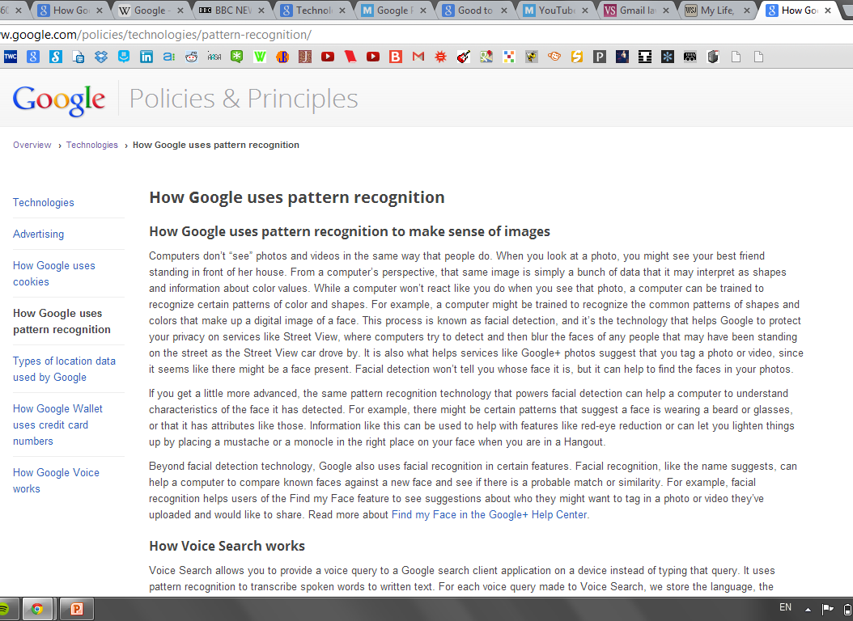

Slide 9
How Google Uses Cookies
“A cookie is a small piece of text sent to your browser by a website you visit. It helps the website to remember information about your visit, like your preferred language and other settings. That can make your next visit easier and the site more useful to you. Cookies play an important role. Without them, using the web would be a much more frustrating experience.”
- Google’s Privacy Policy page

Slide 10
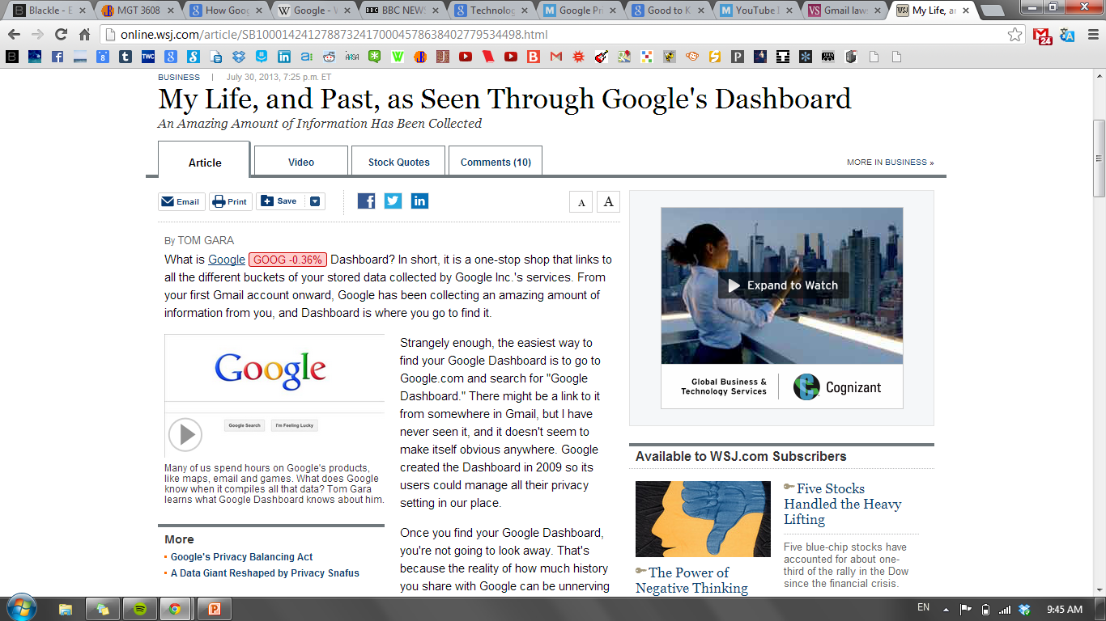

Slide 11
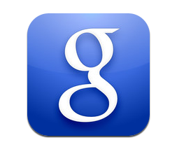
Google Dashboard
What does Google know about me?
“Today, it isn't just all your emails and chat logs, but everything searched for, every YouTube video you watched, all the Web pages you visited, calls you made with Google Voice, even a day-by-day history of every location you have looked up on Google Maps.”
- WSJ

Slide 12
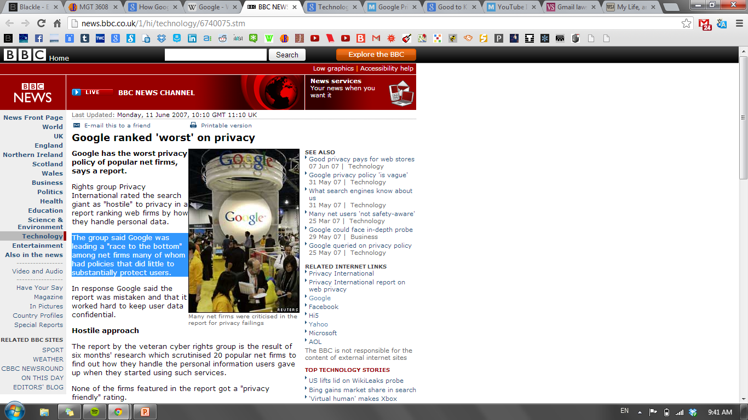

Slide 13
“Google Ranked Worst on Privacy”
“Privacy International placed Google at the bottom of its ranking because of the sheer amount of data it gathers about users and their activities; because its privacy policies are incomplete and for its poor record of responding to complaints.”
- BBC News

Slide 14
The Database
Huge collection of user data
Difficult to delete information
The government can and has asked Google for information, to which they must comply
Compiled information can be used as evidence
Casey Anthony
Steven Zirko
Text messages used in divorce, custody, and other civil cases

Slide 15

Gmail
“Google isn’t manually reading these, a machine is reading them.”
They can’t understand, only detect
Courts need to determine
Is automated scanning a privacy violation?
Statute of limitations
Consent

Slide 16
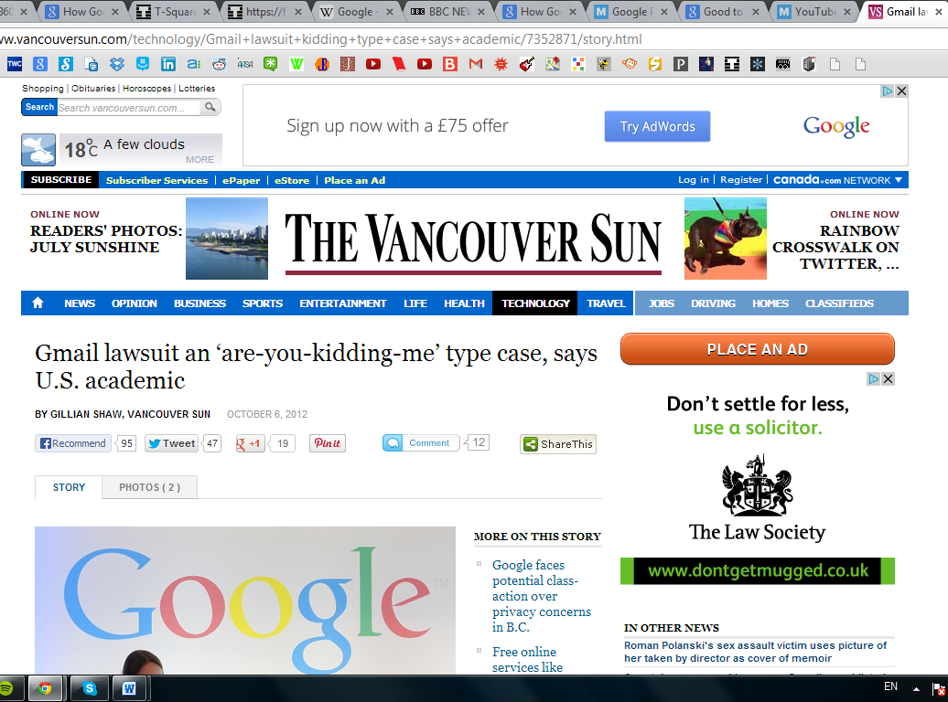

Slide 17
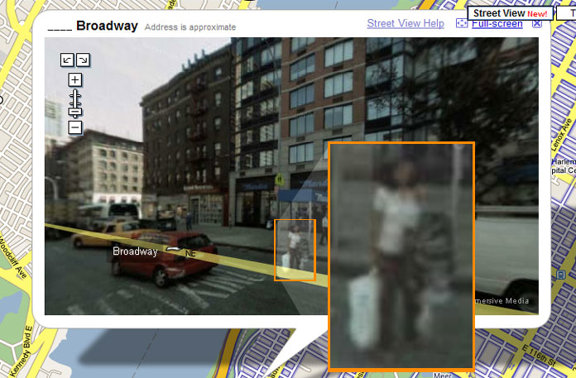
Street View
Public Access Only
Street View images are not real time
Individuals and license plates are blurred

Slide 18
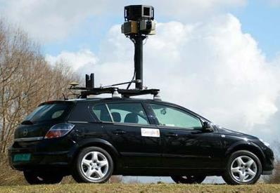
Street View – continued
Street View vehicles collected personal data from wireless networks
$7 million fine
Employee training program
French man sues for 10,000 euros
Homeowners’ privacy, trespassing onto property, negligent acts

Slide 19
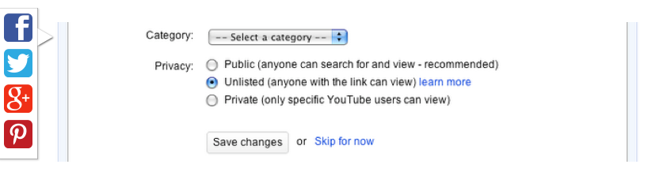
YouTube

Slide 20
The Future
How does a “reasonable expectation of privacy” apply to the internet?
Recent advent Cloud Computing
Example: Spotify vs. iTunes
Opt in/out
The trend is towards sharing as much information as possible
Security is the growing issue

