Slide 1
Privacy and DNA Testing
By: Jeffrey Christian, Rees Curtis, David Kim, and Jenna Zivalich

Slide 2
Overview
History
State Laws Vary
Criminal Cases
Stem Cell Research and Controversy
Privacy Issues and Conclusion

Slide 3
History of DNA Collecting
As early as 1980's, states collected DNA of offenders convicted of sexual offenses
In 1994 Congress authorized the FBI to establish the National DNA Index System (NDIS)
In 1998 the NDIS launched with 9 states
Currently all 50 states and more participate in NDIS
The first state to pass legislation on DNA collecting of criminals was Louisiana in 1997
"a person arrested for a felony sex offense or other specified offense on or after September 1, 1999."
Today 28 states and the FBI allow collection of DNA following arrest or charging

Slide 4
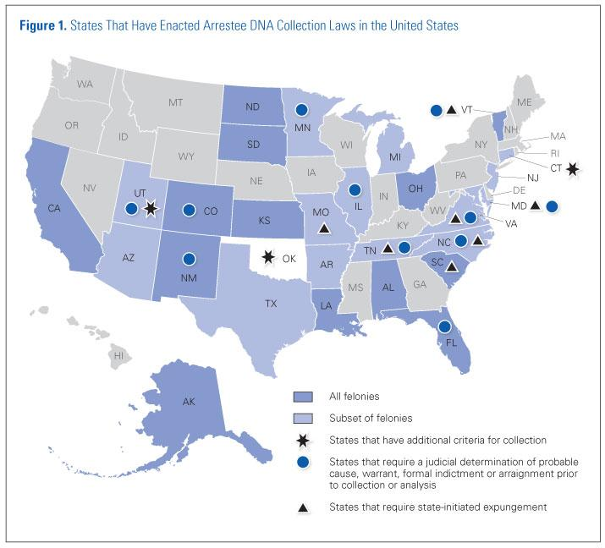

Slide 5
State Laws
Of the 28 state laws authorizing arrestee DNA collection, 13 collect samples from anyone arrested for a felony
Seven states also collect samples in certain misdemeanor cases.
All 50 states and the federal government have laws that require certain convicted offenders to provide a DNA sample for inclusion in CODIS and state databases.
All states have processes in place for expunging a DNA profile if a charge is dismissed or results in acquittal.

Slide 6
CODIS Program and the National DNA Index System
NDIS is one part of CODIS (Combined DNA Index System)
How does CODIS work?
DNA profile is built based on evidence kit collected from the victim
The forensic profile is searched within database of convicted criminals and arrestees
Identity of identity of suspected perpetrator is only revealed upon finding a match

Slide 7
DNA and Property Crimes
The cost of performing DNA analysis is going down
New technologies are more widely distributed
The criminal justice system is learning to use DNA evidence more effectively
For years, DNA was only used for violent of sexual crimes
Recently DNA has been collected from property crimes

Slide 8
Post-Conviction Testing and Wrongful Convictions
Postconviction DNA testing is a major factor contributing to the increased discovery of wrongful convictions
Through the Innocence Project, 307 people previously convicted of serious crimes in the United States had been exonerated by DNA testing since 1989, 17 of whom had been sentenced to death
Currently, all states except Massachusetts and Oklahoma have enacted post-conviction DNA testing statutes

Slide 9
Familial Searching
How do we balance the effectiveness of law enforcement and privacy?
One of the primary privacy concerns regarding the use of familial searching is that it will put innocent people under “genetic surveillance”
Perhaps the most optimal thing to do is universal DNA collection
It has been estimated that using familial searching could increase the cold hit rate from 10% to 14%
Familial searching could potentially disrupt families

Slide 10
History of Stem Cell Research
Mentions of stem cells as early the late 1800's
1961: Till & McCulloch proved the existence
1974: Congress limits federal funding for Stem Cell Research
Frequent federal funding changes
President Obama's Executive Order in 2009 lifted restrictions on federal funding
No federal law has ever banned stem cell research.

Slide 11
What are Stem Cells?
Two Types of Stem Cells:
Embryonic and Adult, or "Somatic", Cells
Embryonic Cells can produce other cells.
Somatic Cells have matured into one function
Regardless of type, they all serve three functions:
Regenerate
Unspecialized
Can develop into specialized cells

Slide 12
Steps in therapeutic cloning are:
1. An egg is obtained from a human donor.
2. The nucleus (DNA) is removed from the egg.
3. Skin cells are taken from the patient.
4. The nucleus (DNA) is removed from a skin cell.
5. A skin cell nucleus is implanted in the egg.
6. The reconstructed egg, called a blastocyst, is stimulated with chemicals or electric current.
7. In 3 to 5 days, the embryonic stem cells are removed.
8. The blastocyst is destroyed.
9. Stem cells can be used to generate an organ or tissue that is a genetic match to the skin cell donor.

Slide 13
Advantages and Pro-Stem Cell
Regenerative Properties:
Develop into new cells
Repair old cells
It's truly unknown the potential until further research
Consequentialism
Utilitarianism

Slide 14


Slide 15
Disadvantages and Anti-Stem Cell
Typical early stages of medical research
A large percentage of opponents are religiously focused.
Mostly attributed to destruction of the blastocyst
Deontological Ethics

Slide 16
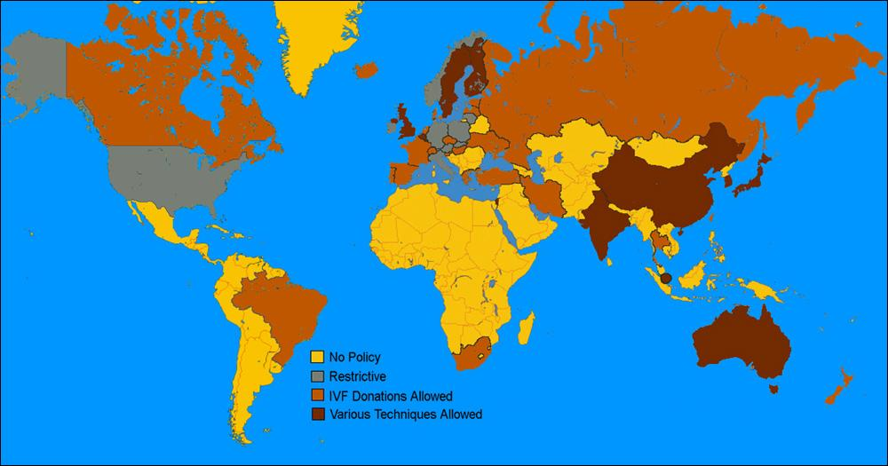

Slide 17
Privacy concerns
two types of privacy interests regarding DNA sampling
1. Governmental Intrusion...both physical and psychological...
profile searched without knowledge or consent
2. Government retention of biological sample
source of private information about suspect & family members

Slide 18
Privacy: the 4th Amendment
“prohibits unreasonable searches and seizures and requires any warrant to be judicially sanctioned and supported by probable cause...”
Forcible, physical intrusion into the body constitutes a search under the 4th Amendment

Slide 19
Violation of my 4th Amendment Rights?
Supreme court rejects challenges by arguing
1. offenders have a “diminished expectation of privacy” by virtue of their status as offenders
2. the “special needs” of law enforcement for efficient investigation of future crimes outweighs an individual’s privacy interest in being excluded from the database

Slide 20
Privacy con't
“DNA dragnants”-collect samples from many individuals meeting a general description
i.e black males living in a particular geographic area
“abandoned DNA”- when police collect dna that is no longer on someone’s person
i.e extracting DNA from a cigarette butt or envelope
“familial searches”-genetic similarity of close relatives allows the use of DNA of one family member to suggest whether another family member has committed a crime

Slide 21
Privacy- GINA
Wed. May 21st, 2008 President Bush signed the Genetic Information Nondiscrimination Act (GINA) which protects Americans against descrimination based on their genetic information when it comes to health insurance and employment

Slide 22
Privacy- GINA continued
What is genetic discrimination?
Why was the law needed?
What is and isn’t included in the law?
How does the federal law affect state law?

Slide 23
Questions?

Slide 24
Bibliography
http://www.webmd.com/a-to-z-guides/features/stem-cells-faq-questions-answers
http://www.nbcnews.com/health/bioethicist-failed-search-controversial-form-stem-cells-shows-danger-mixing-6C10776643
http://stemcells.nih.gov
http://www.dnapolicy.org/images/issuebriefpdfs/DNA,%20Forensics,%20and%20the%20Law%20Issue%20Brief.pdf
http://www.medindia.net/patients/patientinfo/stemcells_adv.htm
http://www.stemcellhistory.com/stem-cell-research-timeline/
http://en.wikipedia.org/wiki/Stem_cell_laws_and_policy_in_the_United_States
http://www.nij.gov/journals/270/arrestee-dna.htm
http://www.fas.org/sgp/crs/misc/R41800.pdf
http://www.genome.gov/10002328#al-4
http://health.usnews.com/health-news/family-health/diabetes/articles/2009/03/13/stem-cells-10-diseases-they-may--or-may-not--cure

