Slide 1
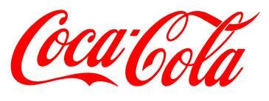
Notes:
Keren Rempe, Drew Traylor, Barkley Yancey, Emily Rabun

Slide 2

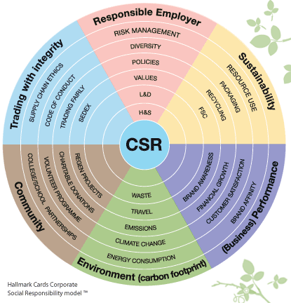
Corporate Social Responsibility
European Commission defines CSR as "the responsibility of enterprises for their impacts on society."
Notes:
Keren

Slide 3
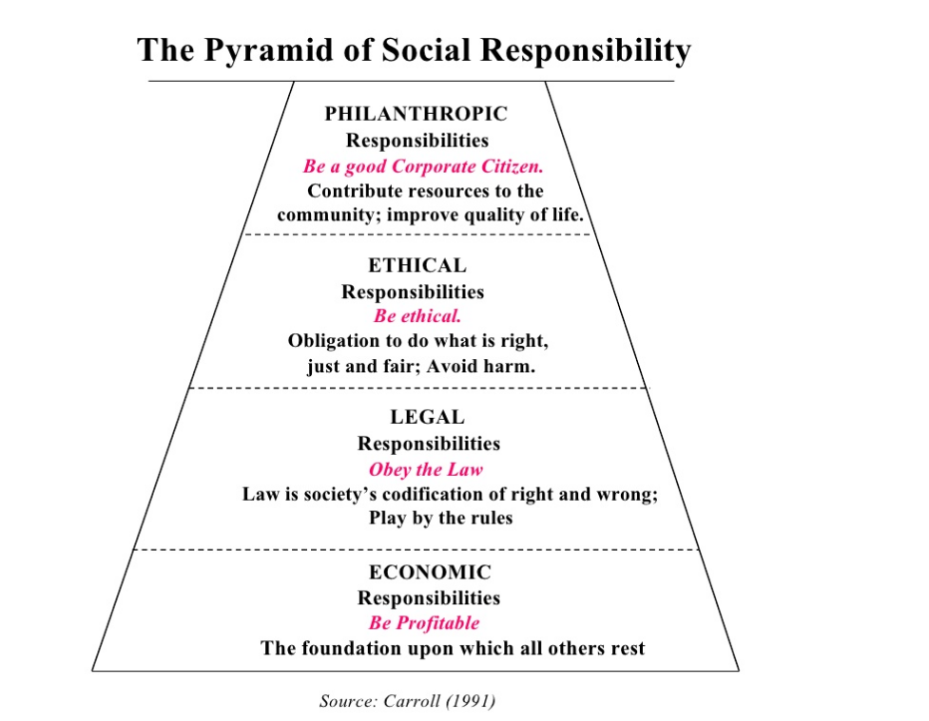
Theory of CSR
Notes:
Keren

Slide 4
Research Question
Do conflicts affect a company’s CSR policy?
Turning point for CSR Policies
Analyzation of Responses to conflicts
How did the company resolve the conflict?
Were there any implementations of specific CSR policies? i.e. measurable targets
Notes:
Keren

Slide 5
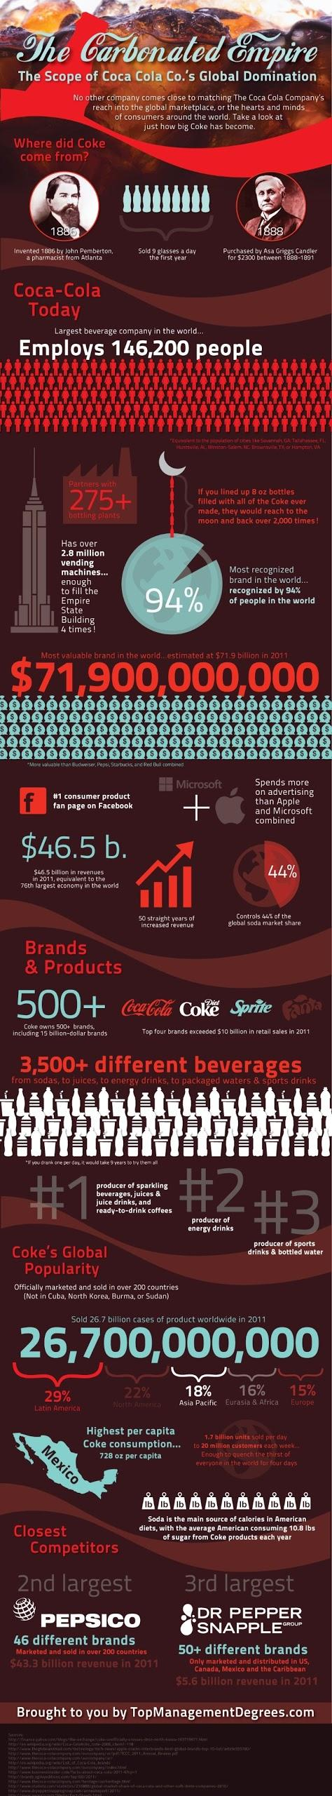
Coca Cola History
Notes:
Keren

Slide 6
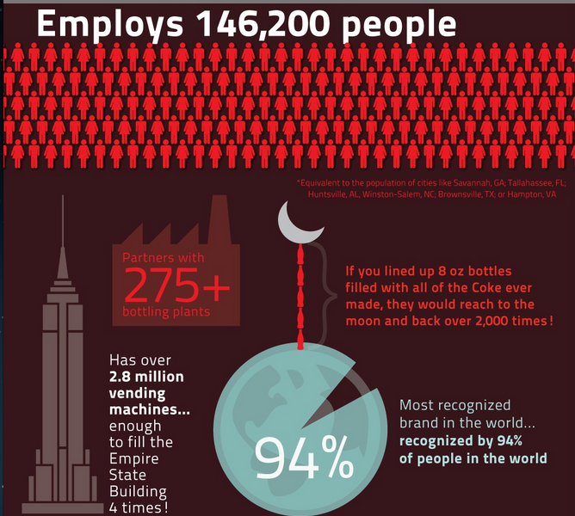
Notes:
Keren

Slide 7

Notes:
Keren

Slide 8
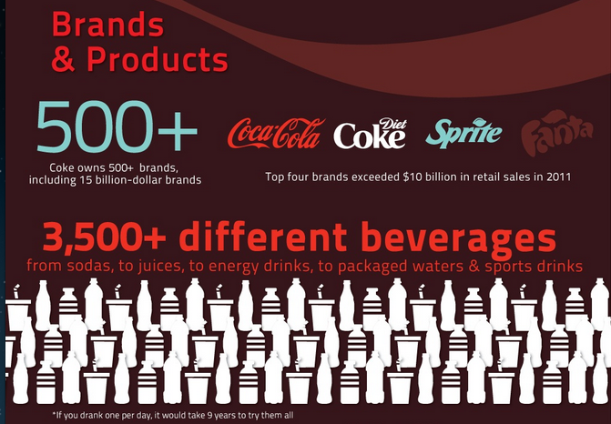
Notes:
Keren

Slide 9
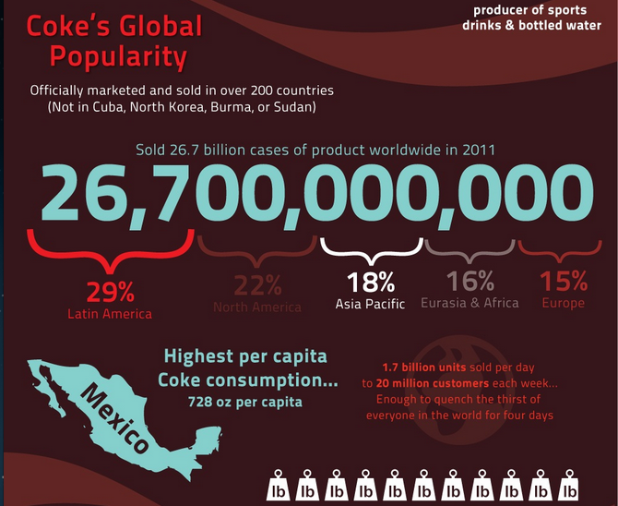
Notes:
Keren

Slide 10
Conflicts for Coca-Cola
in India
Notes:
Drew

Slide 11
Background
In 2003, the Indian NGO Centre for Science and Environment published a report accusing Coca-Cola's Indian subsidiary of selling products with excessive levels of pesticide residues
The report also accused the corporation of over-extracting groundwater and polluting local water sources
Notes:
Drew

Slide 12
Pesticide Presence
In 2003, following the CSE publication, the Indian government formed a Joint Committee to explore the allegations
Tests conducted by the Joint Committee confirmed the findings of the CSE
However, while pesticide levels in Coca-Cola beverages failed to meet European standards, they were in compliance with local law
Although it was found that Coca-Cola had violated no national law, the Indian government recognized the need for increased regulation of the carbonated beverage industry through the implementation of elevated quality standards
Notes:
Drew

Slide 13
Pesticide Presence
A second report was published by the CSE in 2006, this time alleging Coca-Cola pesticide residue levels as much as 24 times higher than European standards allowed
The CSE insisted that the push for increased regulation of the industry had either been lost in committees or stalled by government interests
Following the publication of the second CSE report, the government of Kerala banned the manufacture and sale of Coca-Cola products in the region based on the grounds that high pesticide levels made them unfit for consumption
The ban was overturned by the High Court of India later that year
Notes:
Drew

Slide 14
Pesticide Presence
In 2008, a report published by The Energy and Resources Institute concluded that the water used by Coca-Cola in India was pesticide free, thereby ending the lasting accusations
The findings were nevertheless shrouded in doubt because TERI did not actually test the final product, leaving room for speculation as to the safety of some ingredients not present in the test matter
Notes:
Drew

Slide 15
Water Pollution
Coca-Cola was accused of water pollution through the releasing of wastewater into fields and rivers surrounding its plant in Plachimada, Kerala, southern India
Pollution levels were such that indian public health officials felt compelled to place signs around wells and hand pumps to warn of water that was not sufficient for human consumption
In March 2010, a state governmental panel suggested fining Coca-Cola's Indian subsidiary $47 million for water and soil related damages in Kerala
A committee was also established for the sole purpose of exploring local claims of negative pollutant exposure
Notes:
Drew

Slide 16
Over-extraction
Plachimada locals began complaining of water scarcity soon after Coca-Cola's operations began in the region in 2000
The company was prohibited by the High Court of Kerala in 2003 from over-extracting groundwater, and in 2004 Coca-Cola suspended its Plachimada operations while attempting to renew its license to operate in the area
Coca-Cola was able to successfully argue that water scarcity was more a product of diminishing rainfall patterns than plant operations and received license renewal
Notes:
Drew

Slide 17
Reactions to Pesticide Claims
Coca-Cola denied producing beverages with high levels of pesticides and tried to prove its integrity, rather than working to regain public trust
The poor handling of this controversy caused them to suffer from a damaged reputation and an instant decline in consumer trust.
Sales in India decreased by 40% within two weeks of the CSE releasing its report proving the pesticide counts in the beverages.
Overall annual sales in 2003 were down by 15%.
Notes:
Barkley

Slide 18
Solutions to Pesticide Claims
In 2006, part of the Corporate Social Responsibility Review was dedicated to damage control in India and confirming Coca-Cola's integrity. However, it had little effect on declining sales and losses.
In 2008, Coca-Cola published its first environmental performance report addressing the India controversy and covering events from 2004 to 2007. As well as creating Anandana, the Coca-Cola India Foundation.
Anandana was created to address water problems in and with the local communities through NGOs, Non-governmental organizations.
Notes:
Barkley

Slide 19
Solutions to Pesticide Claims
The greatest strategy of damage control Coca-Cola used was initiating community water projects in India.
For example, the rainwater harvesting project was designed to work with the Central Groundwater Authority, State Ground Water boards, NGOs, and locals to combat water scarcity by harvesting rainwater in 17 of India's states.
Rainwater harvesting basically capturing fresh rainwater and preventing it from evaporation.
In 2012, the Water Stewardship and Replenish Report established that Coca-Cola had achieved its goal through rainwater harvesting of becoming a 'net zero' user of groundwater.
Notes:
Barkley

Slide 20
Response to Controversy
The controversy motivated Coca-Cola to focus more on CSR measures. They established three global objectives dealing with water:
To reduce water usage by 20% between 2004 and 2012 (by 2010 they had already improved by 16%)
To recycle water by an eco friendly water treatment process so that used water can be safely returned to the environment (September 2011: 96% progress)
To replenish used water by offsetting the amount of liters used in finished products through local projects such as rainwater harvesting
Notes:
Barkley

Slide 21
Code of Business Conduct
Since 2001, Coca-Cola has voluntarily used Global Reporting Initiative Guidelines which require the company to produce Company Annual Reviews and Sustainability Reports.
Coca-Cola's Code of Business Conduct aims to set guidelines for its employees to combat competition issues and prevent corruption.
They also implemented international CSR guidelines into the company's policies such as the UN Global Compact.
The UN Global Compact raises awareness of human rights, labor, environment, and corruption.
They also implemented the Live Positively Campaign into all levels parts of the company from production to distribution.
Notes:
Barkley

Slide 22
Live Positively Campaign
Coca- Cola's Live Positively Campaign establishes CSR policies in seven core aspects of business sustainability practices:
beverage benefits
active healthy living
the community
energy and climate
sustainable packaging
water stewardship
the workplace
Notes:
Barkley

Slide 23
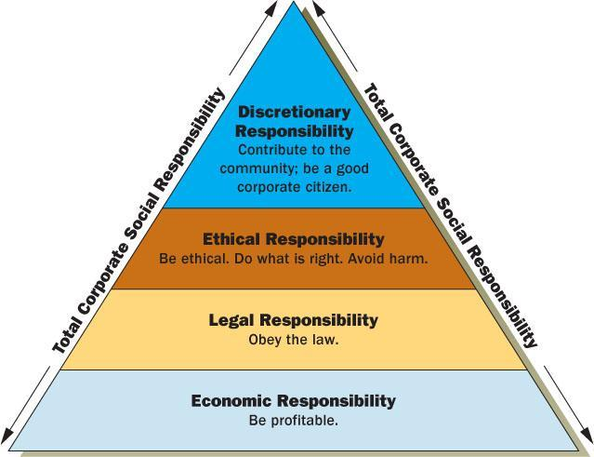
Corporate Social Responsibility
How has Coca-Cola's level of CSR changed over time?
Notes:
Emily
At the start of the conflicts in India, Coca-Cola was actually only following one level of Corporate Social Responsibility theory. It fulfilled it's essential economic responsibility to its stakeholders. However, the point of the conflict was that by having such potentially high levels of pesticides only in it's Indian products, Coke was not fulfilling it's ethical responsibilities. As well, the accusation that Coca-Cola was over extracting water meant that, whether guilty or not, they were not contributing to the community. Finally, by pouring off polluted water into nearby fields and making local water sources undrinkable, Coca-Cola brought harm to the community, and in this case was fined for failing at it's legal responsibility.

Slide 24
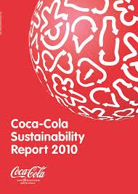
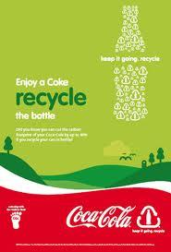



New CSR for Coca-Cola
Notes:
Emily
In the aftermath, Coca-Cola changed its tune. Not only did adjust it's product in India, it also began a vast philanthropic campaign. Now the philanthropic arm of the multinational, the Coca-Cola Foundation, offers on it's website a community support request form. This allows areas in the regions connected to Coke to request help with any troubles they may have, and gives the company a chance to help. Coca-Cola also manages numerous recycling campaigns and positive message ads.

Slide 25
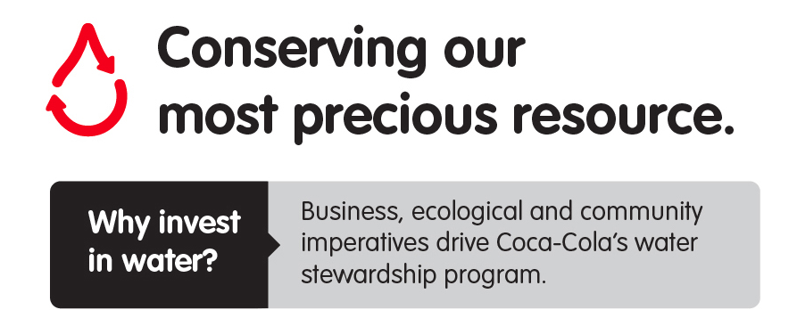
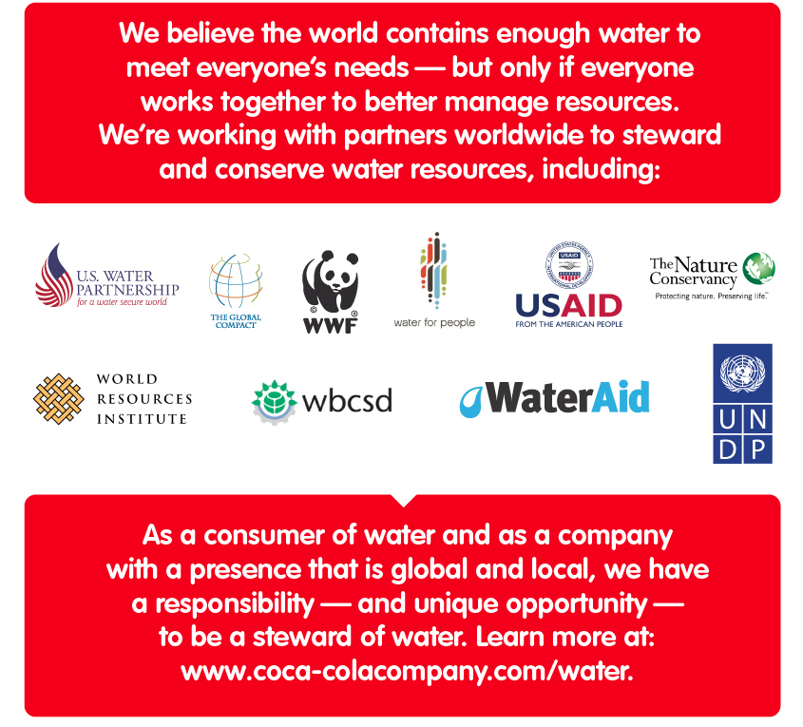
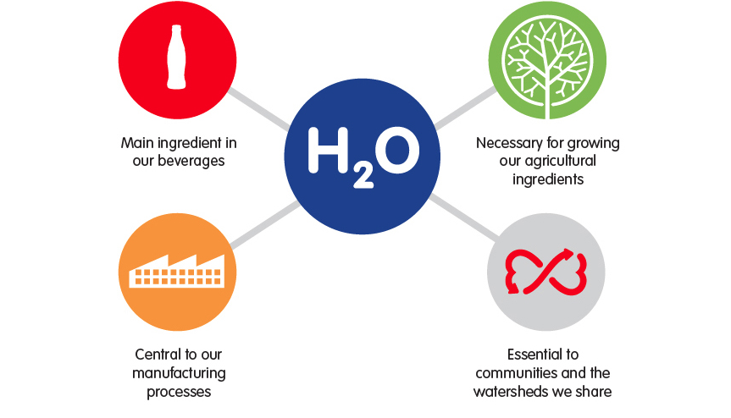
Annual Reports
Notes:
Emily
As well, Coca-Cola releases an annual sustainability report, and an annual water report. The annual water report includes the logos of the many organizations with whom Coca-Cola has partnered to address water scarcity. The report addresses not only the water use of the company but also the ongoing reclamation projects.

Slide 26
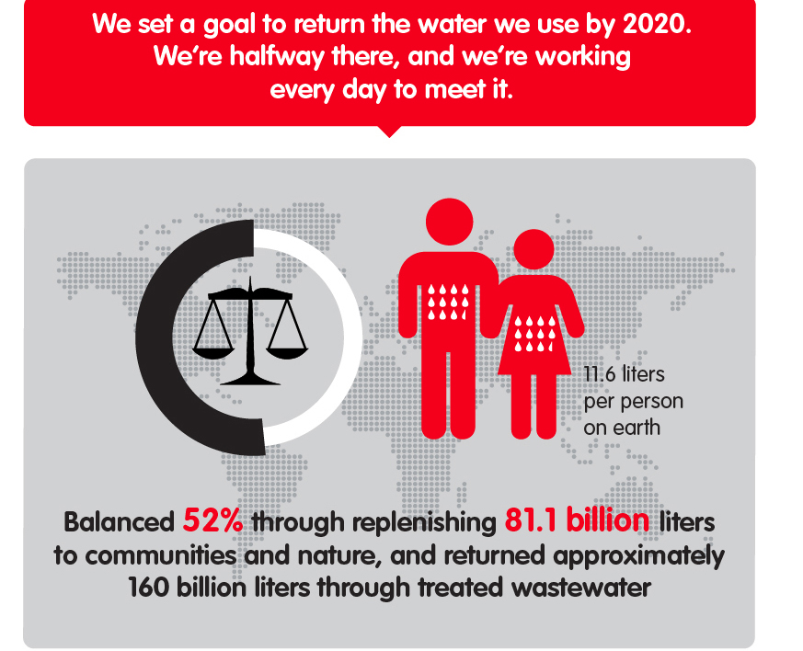
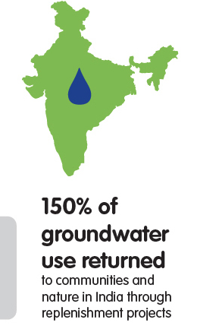
The Research Question
Do conflicts affect a company's Corporate
Social Responsibility policy?
We say yes.
Notes:
Emily
Considering everything we've addressed today, let's revisit the research question:
Do conflicts affect a company's CSR policy?
Based on the action's of Coca-Cola, our group says yes. Coca-Cola had a serious public relations problem on their hands after the conflicts they faced in India. When they restructured their Corporate Social Responsibility policy to include much more focus on the ethical and philanthropic levels, they were able to regain the public's trust and support for their company.

