Slide 1
Canon
By: Sarah Dixon, Sam Gratton, Darrington Altenbern, and Paul Hutton
July 15, 2013

Slide 2

Overview
Background information
CSR policies and reporting
Conflicts:
  Stress-related illness
  Employee regulations
Post-conflict policies
Comparisons
Limiting factors
Conclusion
Notes:
SARAH

Slide 3
Background Information
Headquarters in Japan
Listed on the NYSE
Multiple companies form the Canon Group
  Employs over 190,000 employees
  Canon Inc. has 26,000 employees alone
Consistently granted patents
In 2010, Canon's net sales were ~$45,764 million
Notes:
Canon was founded in 1937
the digital camera is the most popular product, however canon also produces products for office and industrial use

Slide 4
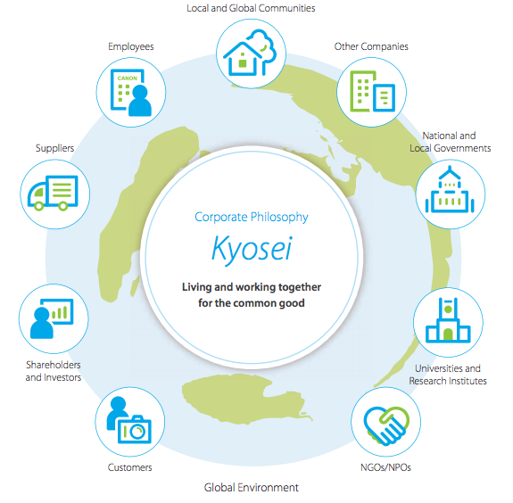
CSR Policies and Reporting
Based off the kyosei philosophy
  "living and working together for the common good"
Follows the GRI Sustainability Reporting Guidelines, 2006
Values keeping the public informed
"Cradle-to-Cradle" philosophy
Notes:
SAM
GRI- global reporting initiative
kyosei is commonly used today in japan in business, politics, and daily life, similar to enlightened egoism/altruism
wants to make sure that the public knows that they follow guidelines in many different countries
active in recycling
cradle -to-cradle - coming up with products that consume less energy

Slide 5
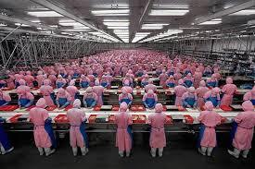
Conflict: Employee Regulations
Canon Electronics Inc.
Demands for standing and walking at a certain pace
Necessity for good management
Notes:
DARRINGTON employers believed this would incresase productivity, and that ppl feel under pressure when tehy are not alowed to sit d own or forced to walk at a certain speed
needed good management to prevent stressfull situations

Slide 6
Conflict: Stress-Related Illness
Branch in Canon Denmark
Result of changes in organization and increasing pressure to perform
Led to development of a stress-reducing policy
  Anti-smoking act
  demands for changes to existing policies
Global outlook
Notes:
SAM
made it a global policy once the government began anti smoking campaigns

Slide 7
Post-Conflict Policies
'Health First' as a Guiding Principle
Shift from reactive to proactive management
Improvement of employee treatment
  no-overtime days
  re-hire retirement employees
  better employee health
Reports on intellectual improvement rather than basic needs
Notes:
DARRINGTON life style checks and tests
japanese groups set targets aiming to prevent lifestyle related diseases
better health-smoking and cholesterol rates dropped

Slide 8
Comparisons
Longest history of implementing CSR policies
Least-serious problems of the four studied
Higher assessment standards concerning employees
Response to conflicts is more proactive
Conflicting sustainability reports
Notes:
PAUL- implemented in 1988
other companies would've viewed employee stress as an inconsequential issue

Slide 9
Limiting Factors
Language barrier
Few articles on conflicts
  lacks official reports
Conflicts do not result in large media attention
Notes:
PAUL little research makes it hard to determine the legitimacy of the conflicts

Slide 10
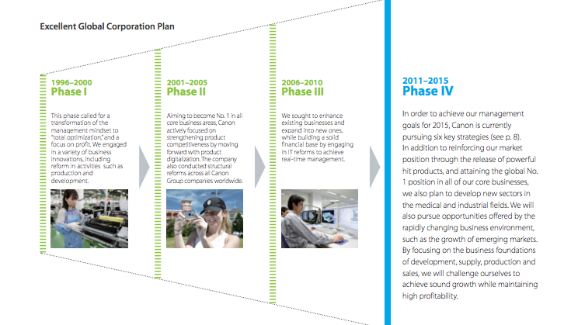
Conclusion
Long-standing CSR philosophy
Reverse path toward corporate responsibility
Notes:
PAUL long standing philosophy could be reason why they dont have as many scandals
first instant it might not be comparable, however article shows that companies like canon still need to be closely monitored and develop their CSR policies as well

