Slide 1

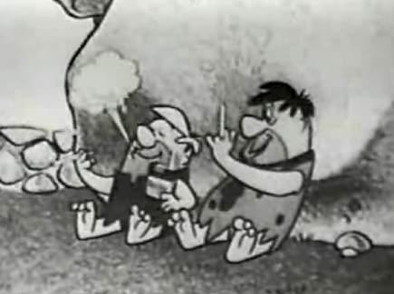
Wanna Smoke ??
Sammy Eastwood
Chelsea Sizemore
Lauren Burns
Brian Seo

Slide 2
Agenda
What is Advertising?
Why Businesses Want It
The Pros of Advertising
The Cons of Advertising
Advertising in Medicine
Advertising in Cigarettes
Anti-Smoking Advertising
Facebook Advertising

Slide 3
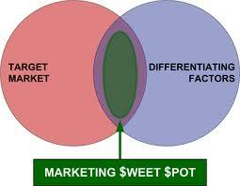
What is Advertising?
Profession of producing advertisement for commercial products or services.
Marketing of goods that
create want or desire

Slide 4

Why Businesses Want It
Best method to reach out to the general public concerning products or goods
Companies differentiate and highlight unique selling points
Advertising stimulates
competition in the market.

Slide 5

The Pros of Advertising
Advertising promotes goods and or services
Network to reach out to many people
Positive outlook on services and or goods
Promotes competition in the market

Slide 6
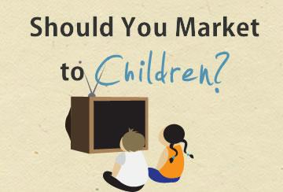
The Cons of Advertising
Promotes materialism, gluttony, impulsive buying, poor shopping techniques
Poor product in reality
Disillusioned results

Slide 7
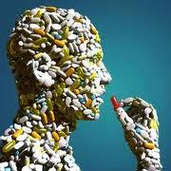

Advertising in Medicine
Pharmaceuticals spent
$28.5 billion in 2011 advertising
Expected increase in advertising

Slide 8
Drug Advertising
•The U.S. & New Zealand are the only developed countries that allow direct-to-consumer drug advertising.
•Lack of technology -
The FDA uses storyboards to review commercials.
•Mass quantity-
The FDA is charged with reviewing about 75,000 pharmaceutical marketing items per year.
•The FDA has a “Bad Ad” campaign that trains doctors to recognize questionable promotions
100 complaints from doctors since its inception.
•http://www.accessrx.com/blog/current-health-news/fda-fails-to-police-drug-medication-ads-effectively-a907/

Slide 9
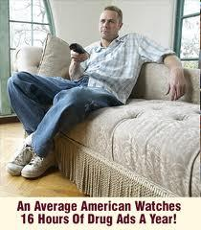
Amount of Ad Time

Slide 10
Regulation Policy Facts
Kefauver Harris Amendments- the FDA began to regulate prescription drug advertisements on Oct. 10, 1962.
Required drug companies to provide information about side effects, etc.
Transferred regulatory authority of drug ads from the Federal Trade Commission to the FDA.

Slide 11
The Industry
May, 2011, the average number of prescriptions for new drugs with DTC advertising is 9X greater than prescriptions for new drugs without DTC ads.
1999-2000, DTC ads increased retail sales of the 25 most popular drug categories by 12%.
Top five-
Antidepressants
Antihyperlipidemics (cholesterol-lowering)
Proton pump inhibitors (acid reflux/heartburn
Nasal sprays
Antihistamines.

Slide 12
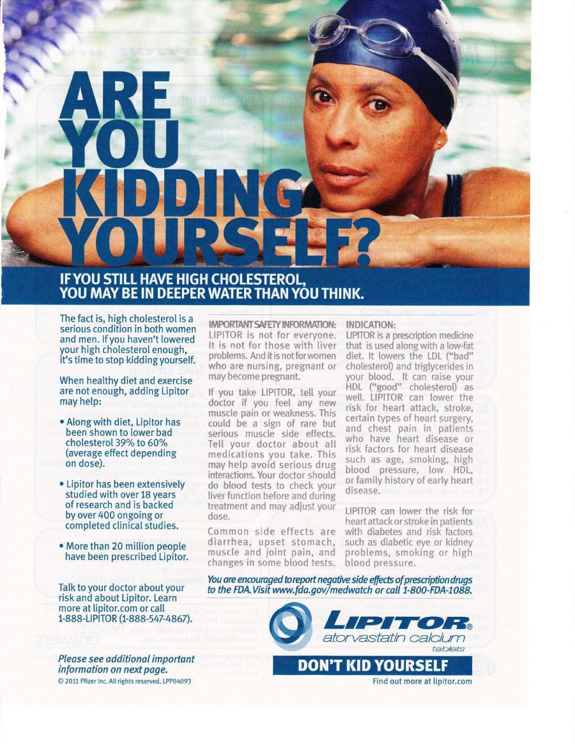
Scare Tactics - High Cholesterol

Slide 13
Drug Ad Cons
Money spent on ads drives up drug prices
Ads mislead to show the drug in the most positive light
Patients pick medicines based on the effectiveness of the ad rather than the effectiveness of the medication itself.
Ads can cause consumers to request certain drugs and self-over-medicate.

Slide 14
Cons Continued
Purpose of advertising funds is to increase profit, not public health
Potentially harmful side effects are not sufficiently detailed in the ads.
Lack of other information available from direct sources of research, such as case study info.
Consumers lose faith in a medical industry that is openly pushing profits, not overall health for the consumers.

Slide 15
Cons Continued
FDA cant review every ad (doesn't have the resources)
Drug ads seem like an easy fix rather than using diet, exercise, stress reduction, and other preventative measures.
Doctors may lose patients if they refuse to prescribe drugs that their patients have seen on television and request.
Write unnecessary prescriptions to keep patients.
Patients may scare from the long list of "potential" side effects.

Slide 16
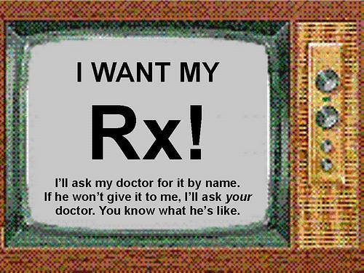
Demanding Public

Slide 17
Drug Ad Pros
Inform consumers about potential medical conditions that they may have and treatments.
More proactive consumers when informed by ads.
Ads provide a helpful public health service by informing the general populace?
How accurate is the information?
There are measures in place that ensure that patients can't just see an ad and immediately acquire a drug.

Slide 18
Pros Continued
Multiple sources of drug education (packaging, doctors, etc)
Patients are more likely to seek treatment because they feel that there condition is more relatable.
FDA regulates prescription drug ads - but how well?
Broad view - advertising as a form of free speech
Protected under the First Amendment?

Slide 19
Pros Related to Profit
Right to make profit-
Without the profits, drug companies can't fund new drug research.
Drug advertising is an entire sub-economy and keeps people employed and a free market, etc.
Brand name vs. generic drug competitors must cover (R&D) expenses.
Profitable for drug makers.
Make over $4.00 for every $1.00 spent.

Slide 20
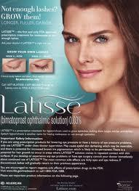
Consumer Wants

Slide 21
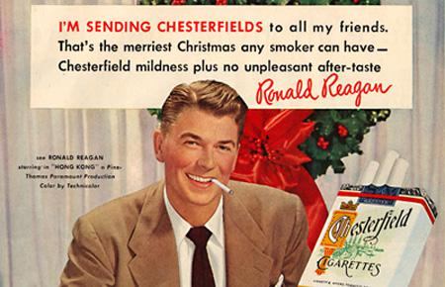
Advertising in Cigarettes
Tobacco advertising is now one of the most highly regulated forms of marketing
September 2001-August 2002, tobacco companies spent 25 million pounds on advertising in the UK
Federal Communication Commission
Public Health Cigarette Smoking Act
Family Smoking Prevention and Tobacco Control Act

Slide 22
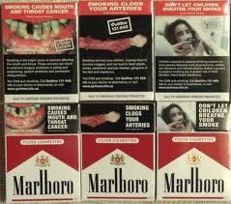
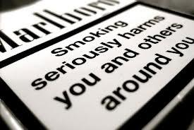
Cigarette Packs
Health warnings must cover 75% of the surface of cigarette packs in the EU
Packs with labels such as light and ultralight are banned because they imply that they are less harmful

Slide 23
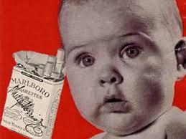
United States v.
Philip Morris
1999, US Department of Justice sued several major tobacco companies for fraudulent and unlawful conduct and reimbursement of tobacco-related medical expenses.
Sued on the grounds that :
1. Mislead public about the risks of smoking/secondhand smoke
2. Misrepresent the addictiveness of nicotine
3. Manipulate nicotine delivery of cigarettes
4. Deceptively market cigarettes as "light"/"low tar" while knowing they were just as harmful
5. Targeting youth market
6. Not making safer cigarettes
2006, judge held tobacco companies liable for fraudulently covering up the health risks and for marketing to children

Slide 24
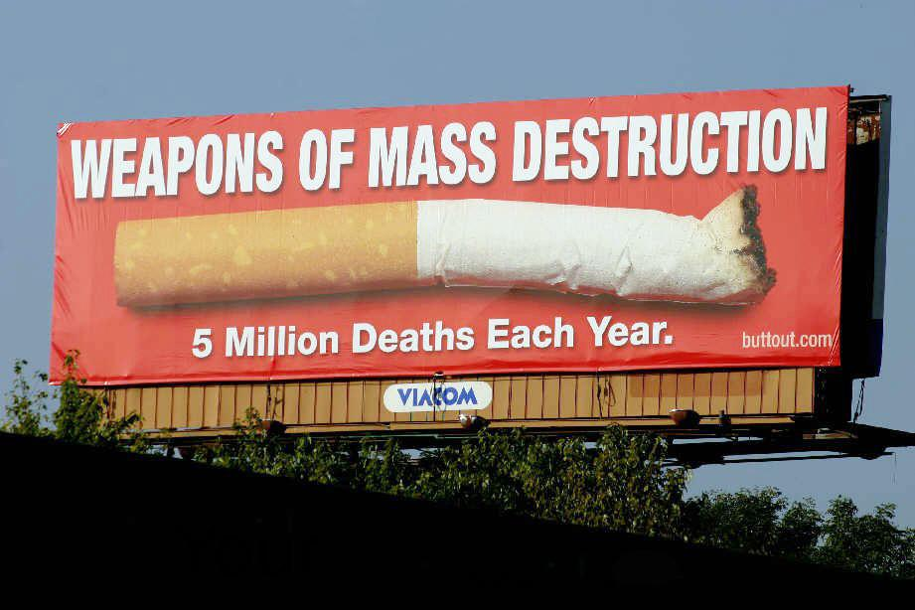
Anti-Smoking Advertising
Cancer charities and government health departments
European Union's "For a life without tobacco" campaign
New York City health department
"Smoking is Eating You Alive" & "Smoking is Eating You and Your Kids Alive"
Marlboro Man
CDC's "Tips from a Former Smoker": https://www.youtube.com/watch?v=5zWB4dLYChM
Now, three billion people are covered by one national, anti-tobacco campaign

Slide 25

Facebook Advertising
Facebook adver-
tising - 819 million
mobile users
Advertising reven-
ues - $1.6 billion
First doubted, but has grown in success of time
Continued growth over 88% for advertising

Slide 26
Direct to Consumer Advertising (DTCA)
- Controversial topic in United States
- First DTCA campaigns were launched in early 1980s
- 40% of total pharmaceutical promotional spending

Slide 27
Why so controversial?
Role of consumers in medical decision making
Appropriateness of consumers engaging in self diagnosis
Ethics of an industry promoting potentially dangerous drugs

Slide 28
DTCA
Opponents: - Argues that it misleads consumers into taking costly prescription drugs that they do not need
- Turning natural human experiences (like hair loss or shyness) into diseases to sell products
Advocates:
- DTCA ads are an appropriate and highly valued source of information for empowering health care consumers

Slide 29
"Wherever regular physicians were weak, there the nostrum maker was strong. Their therapy was brutal, his was mild. Their treatment was costly, his was cheap. Their procedures were mysterious, his were open. Their prescriptions were in Latin, his label could be read by all. Their attack on illness was temporizing, his was quick."

Slide 30
History of Federal Drug Regulation
1906 Pure Food and Drugs Act
1938 Food, Drug, and Cosmetic Act
1938: Wheeler Lea Act
1951: Durham Humphrey Amendments
1962: Keduver Harris Amendments

Slide 31
1906 Pure Food and Drugs Act
Objective: was not to discourage self medication, but to give customers more information so that they could identify effective medicines
US v Johnson - Did NOT prohibit false therapeutic claims but ONLY false and misleading statements about the ingredients or identity of a drug - Sherley Amendment overruled and PROHIBITED labeling medicines with false therapeutic claims intended to defraud the purchaser
Difficult for federal government to prove intent to defraud
Act had little effect on behavior of the patent medicine industry

Slide 32
1938 Food, Drug, and Cosmetic Act
Required, for the first time, that drugs had to be proven safe and to receive the FDAs approval before they could be marketed
Expanded the concept of drug "labeling"
"conspicuousness and in terms such as to render it likely to be read and understood by the ordinary individual under customary conditions of purchase and use"

Slide 33
Durham Humphrey Amendments
Created a statutory definition of prescription drugs
Primary purpose: to avoid patient self diagnosis and self administration of complex and potentially harmful drugs

Slide 34
Wheeler Lea Act
Gave jurisdiction over drug advertising to the Federal Trade Commission (FTC)

Slide 35
Kefauver-Harris Amendments
Dramatically expanded the FDAs authority over prescription drugs by requiring that they be proved not only safe but effective before being marketed
In order to receive approval, the amendments also required drugs to meet a high standard of scientific evidence
Transferred jurisdiction over the advertising of prescription drugs from the FTC to FDA

Slide 36
FDCA requirements on labeling
1. Contain drugs established name
2. The formula showing each ingredient
3. Brief summary of the side effects, contraindications and effectiveness

Slide 37
Concerns of DTCA
May undermine physician control over prescribing
Most consumers are ill equipped to evaluate the efficacy or toxicity of drugs
Hurt doctor-patient relationship
Confuse an unsophisticated public
Lead to higher drug costs

Slide 38
Rise of DTCA
Decline in trust between patient and physician
Many of the top-selling drugs switched from prescription to over the counter (OTC) status
Products promoted were focused more on improving quality of life than on treating disease
Required consumers to self-identify and inform themselves and become more involved in medical decision making

Slide 39
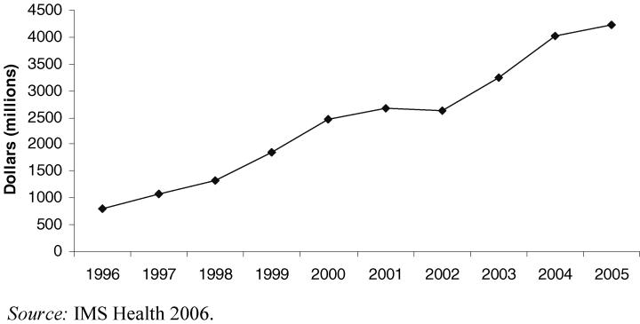
DTCA advertising raised from $1.3 billion in 1998 to $3.3 billion in 2005

Slide 40
Change in view
1997: 80% of physicians believed DTCA was not a good idea
2002: only 18% believed DTC created problems
41% said DTC had beneficial effects on the interactions

Slide 41
Thank You!
Sammy Eastwood
Chelsea Sizemore
Lauren Burns
Brian Seo

