Slide 1
Jay z, amazon and privacy intrusion
Ben Miller

Slide 2


Slide 3
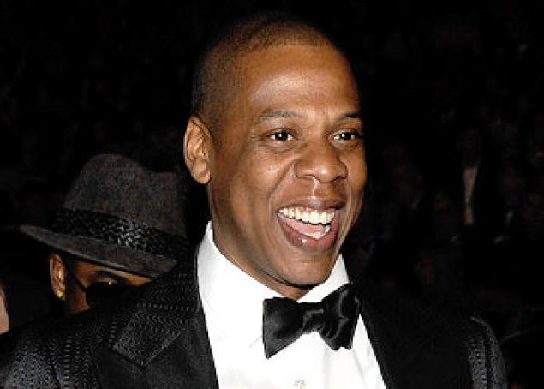
Shawn “Jay Z” Carter
Rapper, Producer, Entrepreneur, Investor and Sports Agent
Worth nearly $500 Million
Arguably the most successful hip hop artist of all time with over 50 million albums sold worldwide

Slide 4
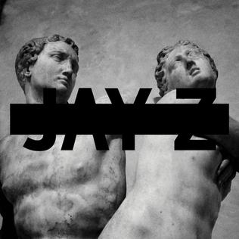
The Album – MC | HG
Jay Z’s 12th studio album
Debuted #1 on Billboard top 200
Made platinum status the first day (1,000,000 copies sold) due to deal with Samsung
Released for retail July 8th, but Samsung users could get exclusive access on July 4th if they purchased an app for $5

Slide 5
Samsung Privacy Agreement
In order to download the new album, users had to agree to a privacy statement allowing Samsung access to personal data including: Storage, System Tools, Your Location, Network Communication and Phone Calls.
Users also had to log in through Facebook and Twitter, as well as give the app permission to post on the user’s behalf
If the user wanted extensive lyrics for the album, they had to agree to promote the album on social media even more

Slide 6

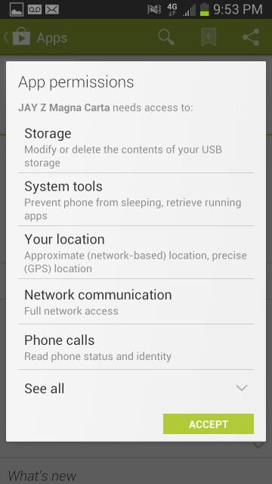
App Screenshots

Slide 7


Amazon and Chrome
Amazon has released a Google Chrome plugin that allows users access to many useful features while browsing the web
Over 1.8 million people have downloaded this plugin so far

Slide 8
Amazon and Google Chrome
Get special offers and features right at your fingertips with The Amazon 1Button App for Chrome. View price comparisons while shopping online, search Amazon and the Web at the same time, get a head-start on deals, and more. Get special offers and features right at your fingertips with The Amazon 1Button App for Chrome, including:
Today’s deals: Get a ten minute head start
Top ten: Check out what’s popular across categories
Add to Wish List: Easily build your Wish List around the Web
Price Compare: View alerts while shopping online
Amazon Smart Search: Search Amazon and the Web at the same time
Cloud Player: Play your digital music anywhere
Cloud Drive: Easily access your files
Cloud Reader: Read Kindle books instantly in your Web browser

Slide 9
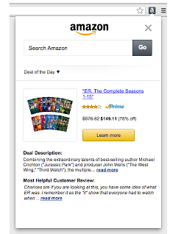
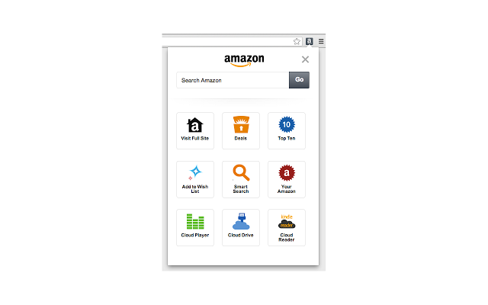
The Web App

Slide 10
Why is this so bad?
This seemingly harmless app reports to Amazon every URL you visit, even HTTPS URLs
It does so via secure HTTPS sessions so only Amazon is able to see that data.
The browser extension also reports to commercial Web traffic data provider Alexa -- an Amazon subsidiary -- the content of some sites visited, including the first few results generated by Google searches, even when made using HTTPS.
That data is routed via HTTP, which makes it easier for hackers to gain access to that data

Slide 11

“Shooting fish in a barrel”
This app practices ‘poor plug-in hygiene’ as hackers can easily exploit this data collection and gain access to user’s personal data
Amazon has fixed this hole in the software, however it still collects user data

Slide 12
Am I protected from this?
It seems that both Samsung and Amazon are collecting much more data than necessary to allow functionality of these two apps, but are users being mistreated?

Slide 13

Invasion of Privacy Tort
Interest in Personal Information
Appropriation of name and likeness?
False light?
Publication of private, embarrassing facts?
Intrusion upon selection?

Slide 14
Intrusion upon selection
With technology advancing rapidly, access to personal data on the internet is easily obtained by companies (which we have just seen)
Should companies be allowed to take your data and use it?

Slide 15
Fair Information Practices
Notice / Awareness
Choice / Consent
Access / Participation
Integrity / Security
Enforcement / Redress

Slide 16
In these cases, the user said “Sure!”
While this is a growing issue that does not have a universal answer for what companies can and cannot do, in both of these cases, users said ‘I agree’ when prompted to allow Samsung and Amazon to collect their data
Moral of the story: READ THE PRIVACY STATEMENT

Slide 17
Web Articles Used
http://threatpost.com/amazon-1button-browser-add-on-leaks-data-in-plain-text
http://www.rollingstone.com/music/news/jay-zs-magna-carta-holy-grail-app-under-investigation-by-privacy-group-20130716
http://www.latimes.com/entertainment/envelope/cotown/la-et-ct-privacy-group-calls-for-ftc-investigation-of-jayz-app-20130715,0,2061600.story
http://www.informationweek.com/security/privacy/jay-z-app-amazon-extension-slammed-on-pr/240158281
I still think Jay Z is one of the best rappers of all time

