Slide 1
Facebook Privacy
Sarah Pospisil
Peyton Proctor

Slide 2
Brief History
Created by Mark Zuckerberg in 2004
  stemmed from Facemash
Originally for Harvard undergraduate students
Expanded membership to any person 13+ with a valid email by 2006
Went public in Spring 2012
  3rd largest IPO in American history
Now boasts 1.11 million users
  4.5 million likes per day

Slide 3
Relevancy
Network concept
  personal information
New technology = New pattern of interaction
If you’re not the customer, you’re the product

Slide 4
Note:
The following video is shown for educational purposes, deemed fair use under Section 107 of the Copyright Act

Slide 5


Slide 6
Application Programming Interface
Launched in 2007
Allows third parties to create applications with access to Facebook databases
  added by the user
  pre-selected choices about what is published and collected
Clicking “add” gives access to:
  Name
  Hometown
  Political view
  Activities
  Work history
  Relationship history
  your friend’s information

Slide 7
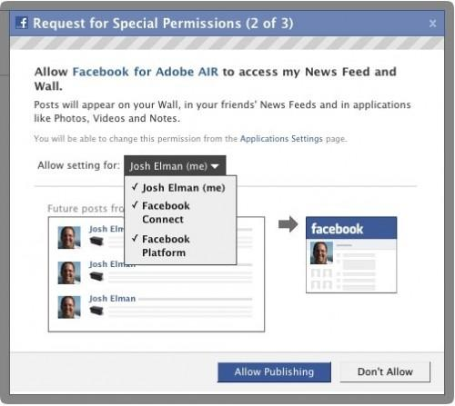
API Pop Up

Slide 8
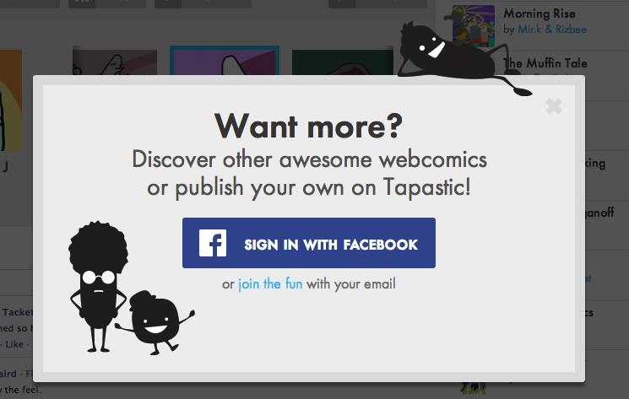
Sign in with Facebook

Slide 9
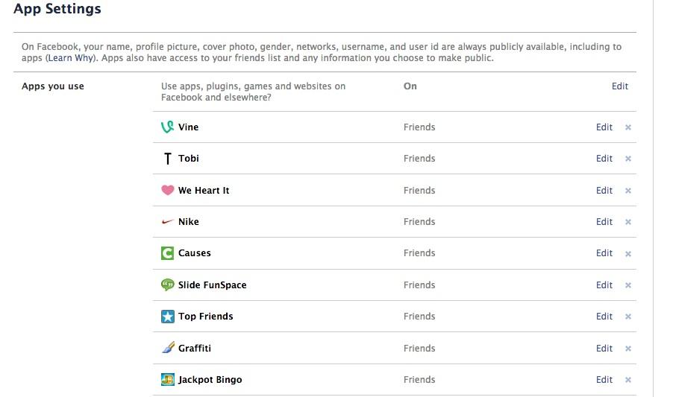
Third Party Apps

Slide 10
New “Privacy” Measures
Under the revised privacy policy, Facebook now treats the following categories of personal data as “publicly available information:”
• users’ names
• profile photos
• lists of friends
• pages they are fans of
• gender
• geographic regions
• networks to which they belong

Slide 11
New “Privacy” Measures
88% of Facebook users opposed the changes to privacy policy and voting rights
  Largest vote in Facebook history
This information is given to internet search engines and other companies
  target advertising
  statistical/demographic purposes
Before the privacy policy changes, only name and network were publicly available

Slide 12
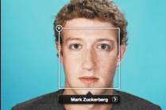
Facial Recognition
To make tagging easier, Facebook has implemented a facial recognition feature.
Facebook scans your photos, gathers information about your face (such as the distance between your eyes, mouth or other features), and creates something like a “face print” that is relatively unique to you.
When someone else uploads a photo, Facebook’s systems can look through the face prints of their friends, and suggest to them that it’s you.

Slide 13
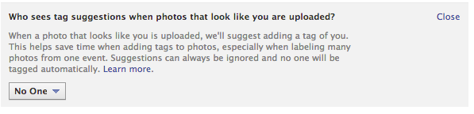
Facial Recognition
Uses a tool called privacyfix
This tool essentially deletes your “face print”

Slide 14
Advertisements
How do personalized ads work?
Facebook does not share any of “your information”
-registration information (email, gender, birthday, etc)
-information you choose to share (status updates, pictures, comments)
but they can share “public information”
-name, profile and cover photos, username

Slide 15
Can use your information if it no longer is personally identifiable to you
Can use “information received about you”
  time, date, location of a posted video
  use GPS to know what friends/events are nearby
  other websites using facebook platform
All is used “to make facebook better”

Slide 16
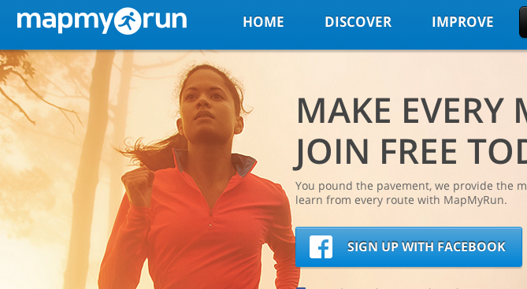
Connect with Facebook Example

Slide 17
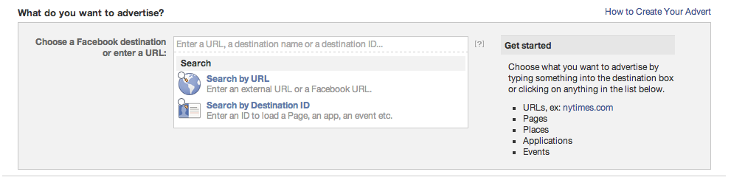
Creation of Advertisements
1. Choose a Destination

Slide 18
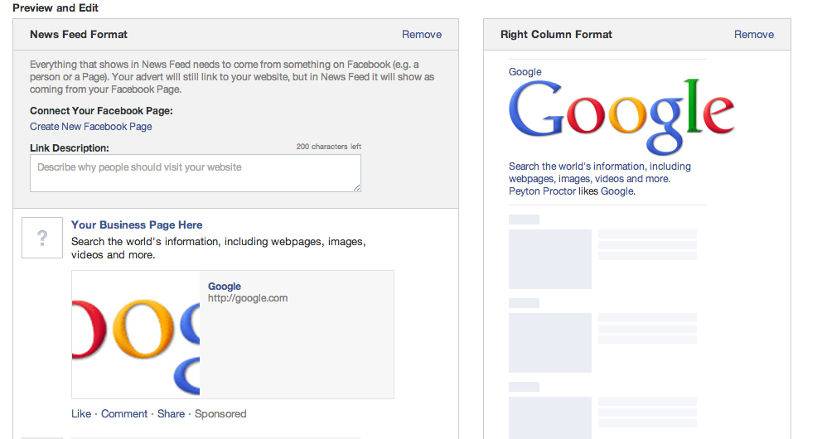
Creation of Advertisements
2. Preview and Edit: shows how the ad will come up on a user’s newsfeed

Slide 19
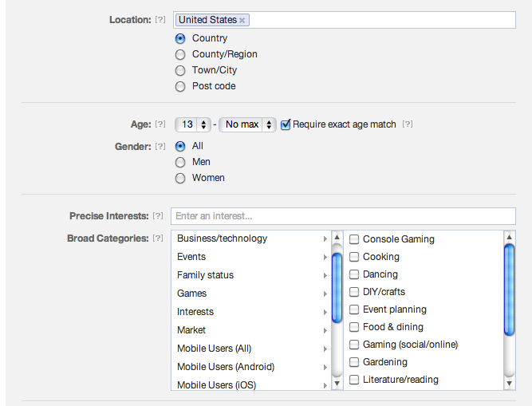
Creation of Advertisements
3. Choose the audience (here is where the privacy issues
come into play)

Slide 20
Creation of Advertisements
Advertisers can choose audience by
  location
  likes
  demographics
  keywords
For example, an advertiser can choose to target 18 to 35 year-old women who live in the United States and like basketball.
advertisements only used to “enhance your Facebook experience”

Slide 21
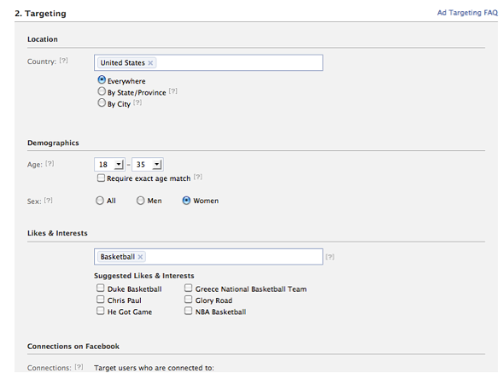
Ad Targeting

Slide 22

Facebook makes generalizations about user’s “likes”
  if a person "likes" the "Star Trek" Page and mentions "Star Wars" when they check into a movie theater, Facebook may conclude that this person is likely to be a sci-fi fan.
Uses friend’s “likes”
to make advertisements
appear more personable

Slide 23
Beacon Advertising System
Launched in 2007
Third-party websites
  data collected from outside Facebook was brought into the social network
    included people who opted out
    included people without a Facebook account
Broadcasts a user's interaction with an advertiser to the feeds of that user's friends
  did not allow global opt-out
  posts messages on users’ behalf without permission

Slide 24
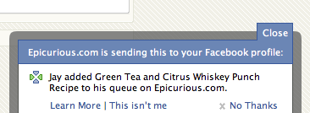
Beacon Example
User must click “No Thanks” to opt out

Slide 25
Beacon Lawsuit
Facebook made multiple deceptive privacy claims
  frequent changes in layout settings
  Third-party apps given more personal information than allowed
  Safe Harbor Framework ignored
Settlement requires
  giving consumers clear and prominent notice
  maintaining a comprehensive privacy program
  must obtain consent before sharing information passed consumers’ privacy settings

Slide 26
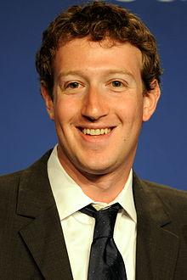
What Zuckerberg says
“I think that a small number of high profile mistakes… have often overshadowed much of the good work we’ve done.”
Zuckerberg believes the company is making great strides in their privacy policies:
“We can also always do better. I'm committed to making Facebook the leader in transparency and control around privacy.”

Slide 27
Changing Privacy as We Know It
According to Facebook’s 29 year-old CEO,
“People have really gotten comfortable not only sharing more information and different kinds, but more openly and with more people," he said. "That social norm is just something that has evolved over time."
New changes urge people to be more open about what information is published online
Most people do not realize how much information is automatically released to companies and other users

Slide 28
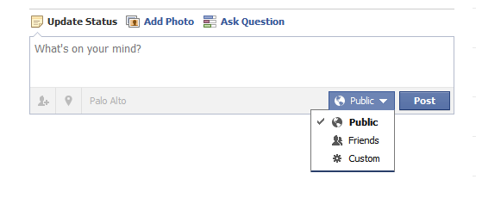
Sharing on Facebook
Anytime you post anything, you can select an audience
  status update, picture

Slide 29
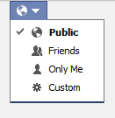
Sharing on Facebook
You have control over who sees things that you have posted
But when you comment or like something on someone else’s timeline, they get to decide the audience
Sharing icon

Slide 30
Sharing on Facebook
When you hide things on your timeline, it means those things will not appear on your timeline.
But anyone in the audience of those posts or who can see a connection may still see it elsewhere, like on someone else's timeline or in search results.
Hiding something from your timeline does not mean you are deleting it

Slide 31
Legal Requests
Facebook has the right to access and share your information in response to a legal request if they feel the law requires it
Legal Instances:
  In case of fraud, illegal activity, to protect the Facebook name, protect the user, etc.

Slide 32
The Scary Bottom Line
We don't want you to change your privacy settings
  and it’s difficult to do
Leaving your information public can put make you a target for Facebook scams
We have little control over application security
We know which websites you're visiting
Your information is being stored in places outside of Facebook

Slide 33
Questions?

